Slide 1
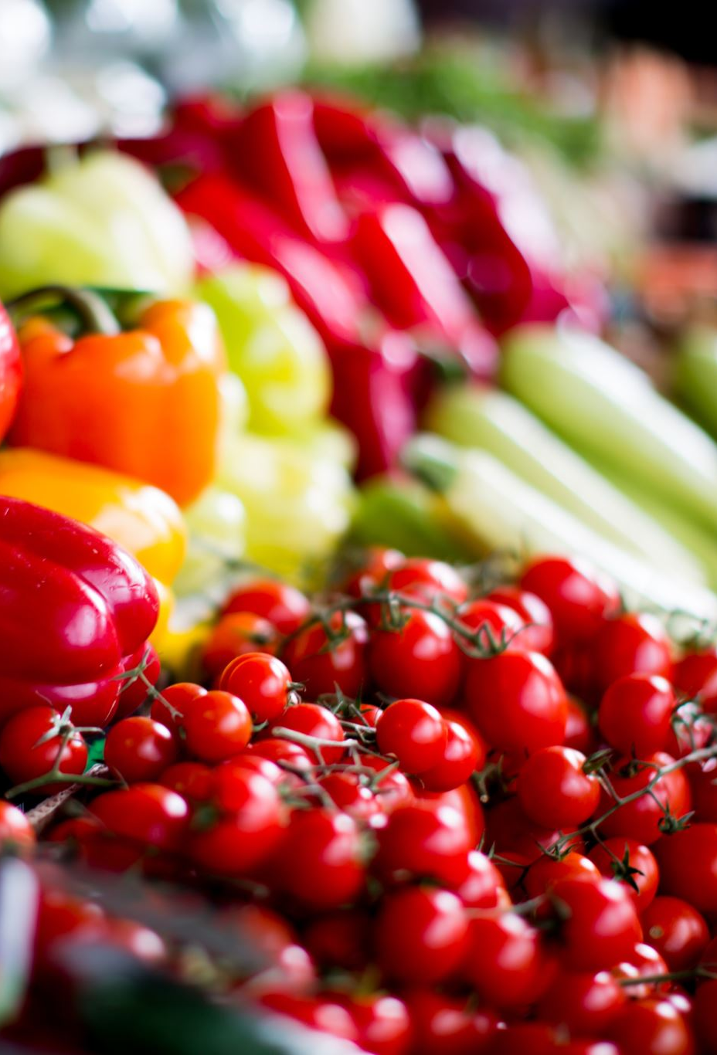
Food Expense
What impacts Store Expense Behaviour?
Metro College of Technology
November 2021
Ana Clara Tupinambá Freitas, oriented by Professor Arkar Min

Slide 2
Outline
Introduction
Executive Summary
Business Questions
Methodology
Phase 1:Identification of target variable
Data profiling
Data preparation
Visuals
Phase2: Model
EDA /Data preparation
Hypothesis
Modeling
Results
Conclusion & Recommendations
*Appendix
Tabular summaries, Extra Graphs and SAS Script

Slide 3
Introduction
The Survey of Household Spending (SHS) collects detailed spending information (User Guide from the SHS PUMF,2017 from Statistics Canada )
Shape: 4012 x 437 more than 14 millions datapoints
45 categorical (CaseId)
394 numerical (WeightD – Frequency)
Study data refers to Food Expenses based on a daily expenditure that spans over a 2-week period […]that was annualized. […]Data on income […]come mainly from […]the Canada Revenue Agency from the preceding year. (User Guide from the SHS PUMF,2017)
SAS Enterprise Guide, Excel and Adobe Acrobat reader was used in this study.
https://www150.statcan.gc.ca/n1/pub/62m0004x/62m0004x2017001-eng.htm ...
weight

Slide 4
Executive Summary
To know how much a household spends on food can help stores decide which products maintain in shelfs and give insights to marketing.
This study has 2 phases:
Identification of product with biggest expense nationally
Identification of what impacts the expense of the identified product.
To maintain revenue, the recommendation is that special attention should be applied for stock keeping and marketing for areas with characteristics that leads to higher spending.
Investigate and address areas with less spending to increase sales.

Slide 5
Business Questions ?
Which product expense is the biggest regarding store purchase?(target)
Is the expense diverse regarding geography (Region and Province)?
Is the expense diverse regarding Household Type?
Does higher Household Income mean higher expense?
What impacts the expense of the previously identified product?

Slide 6
Which product expense is the biggest regarding store purchase?

Slide 7
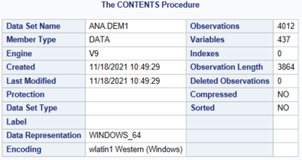
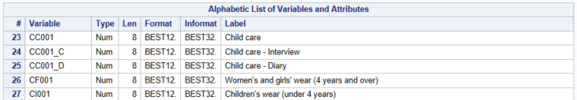
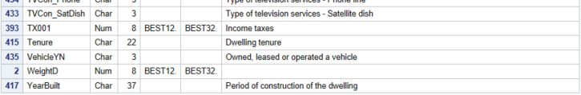
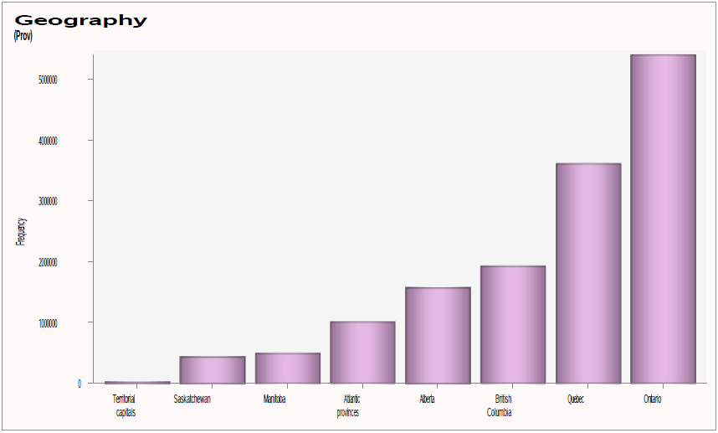
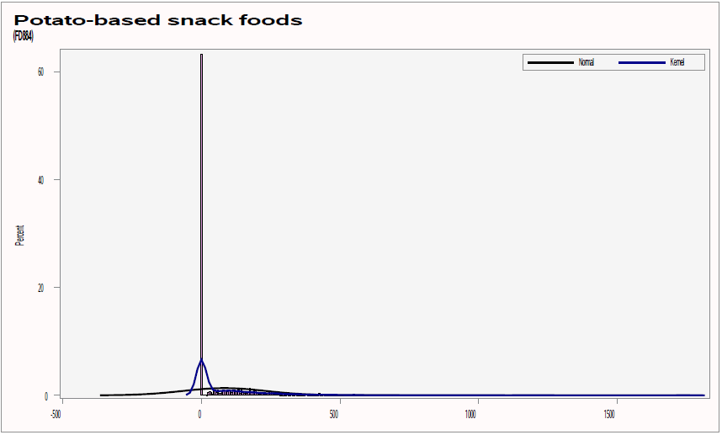
Original Dataset Profiling
.
.
.
Examples

Slide 8
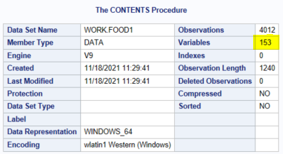
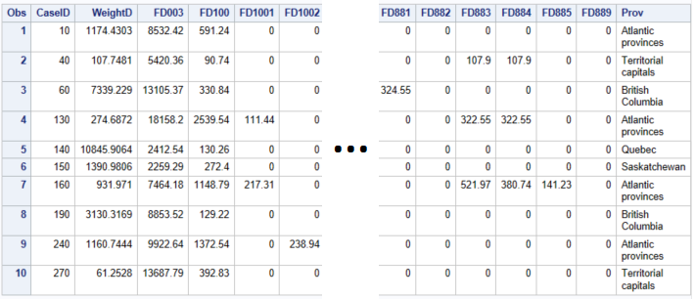
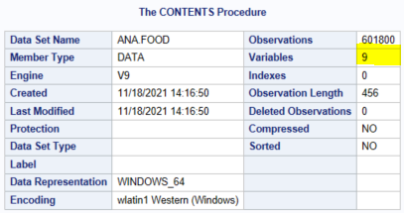
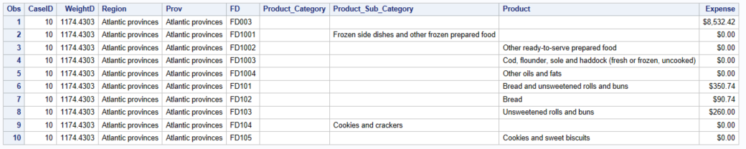
Data Preparation
Product Category
Product SubCategory
Product

Slide 9
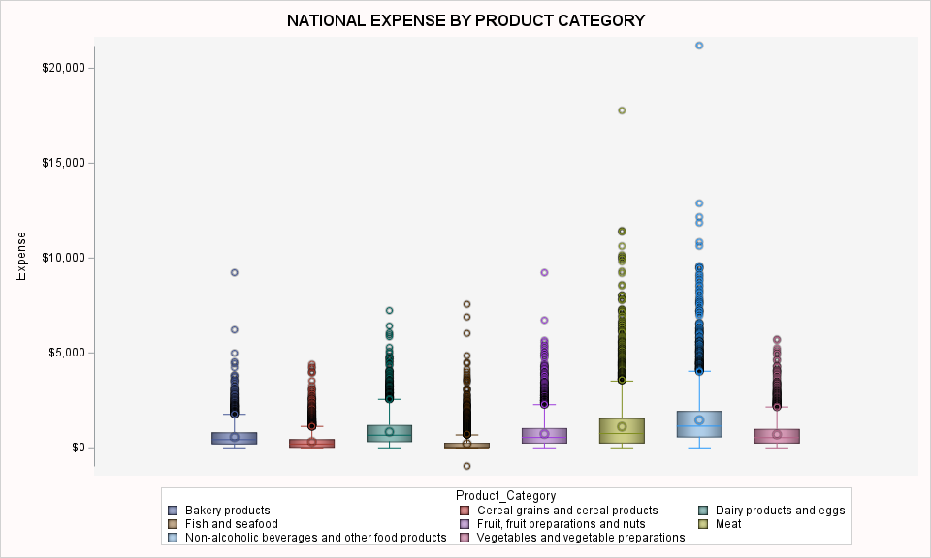
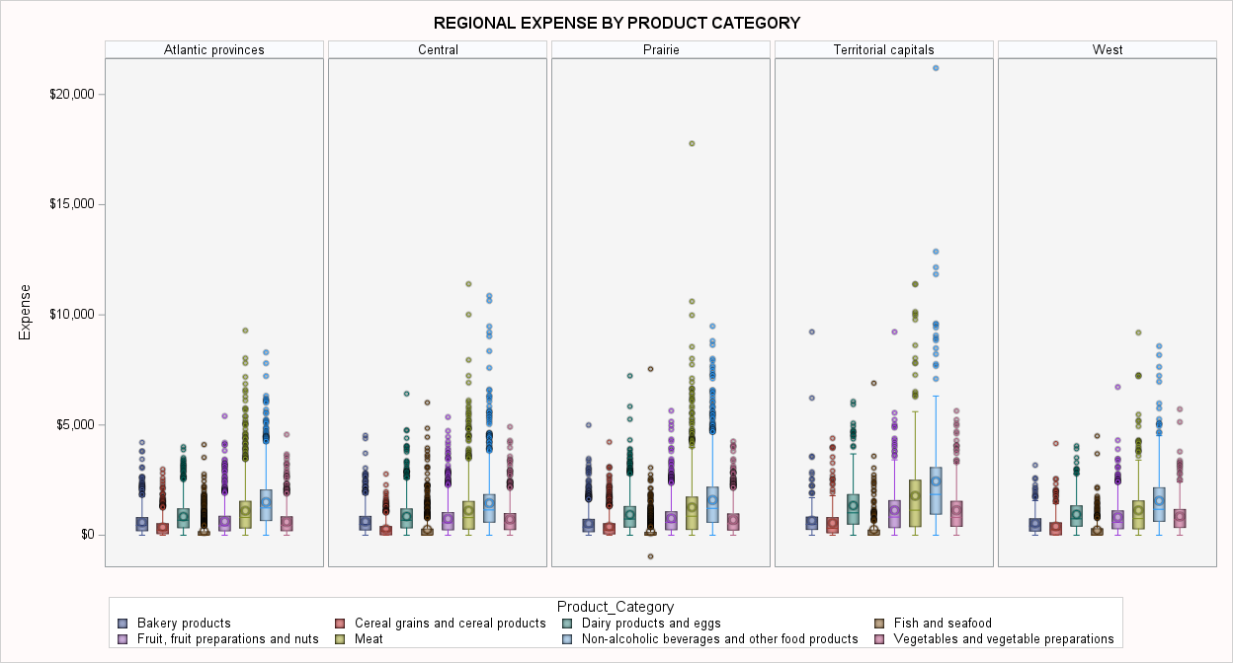

Slide 10
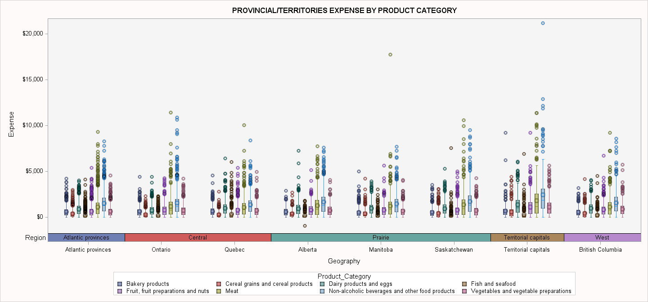

Slide 11
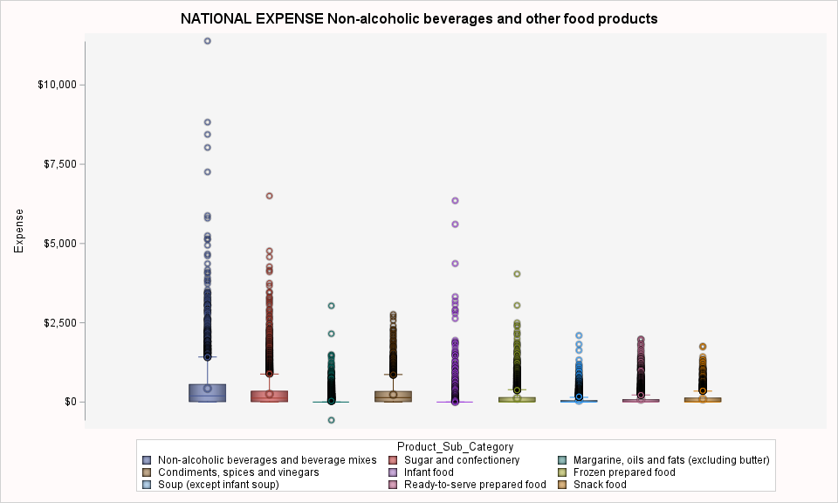
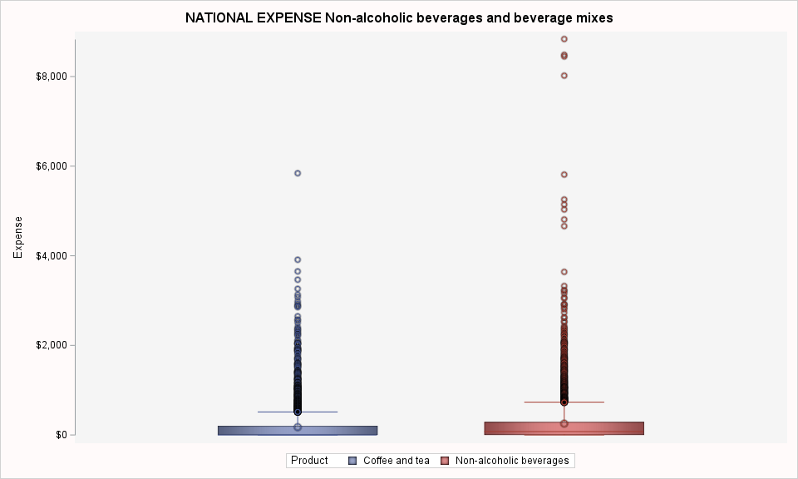
*

Slide 13
Study Framework
Total Income
Region
Province
Household Type
Reference person - Age group
Expense
(Non-alcoholic beverages)
Reference person - Education level
Reference person - Marital status
Reference person - Sex
Spouse - Age group
Spouse - Education level
Spouse - Employment status
Spouse - Sex

Slide 14

Exploratory Data Analysis

Slide 15
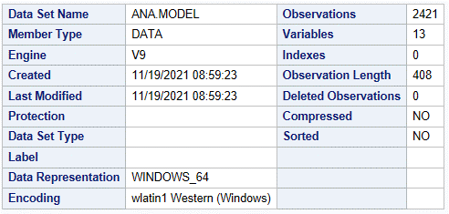
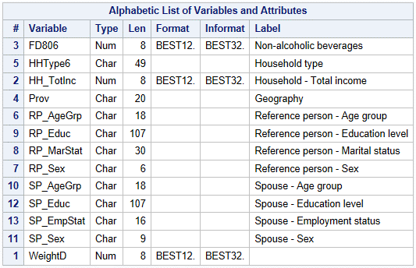
Data Preparation
Sub setting
Exclusion of outliers
Exclusion zero expense

Slide 16
Hypotheses
Different expense groups :
Household dimension:
Region
Geography(Province)
Household Type
Reference Person dimension:
Age Group
Marital Status
Education Level
Sex
Reference Person dimension:
Age Group
Employment Status
Education Level
Sex
Household Income is associated with higher Spending

Slide 17
Univariate Analysis

Slide 18
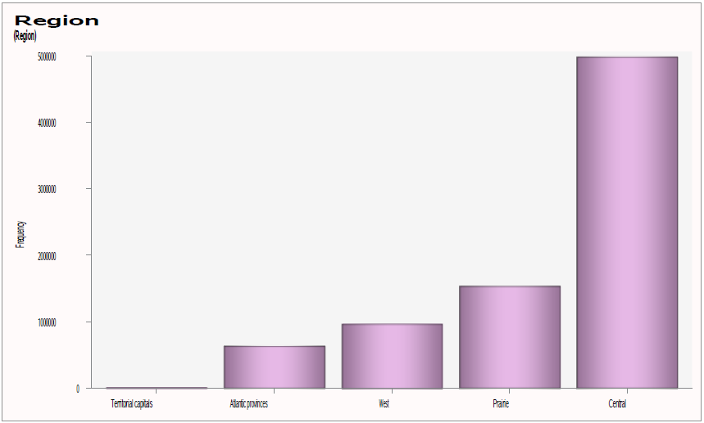
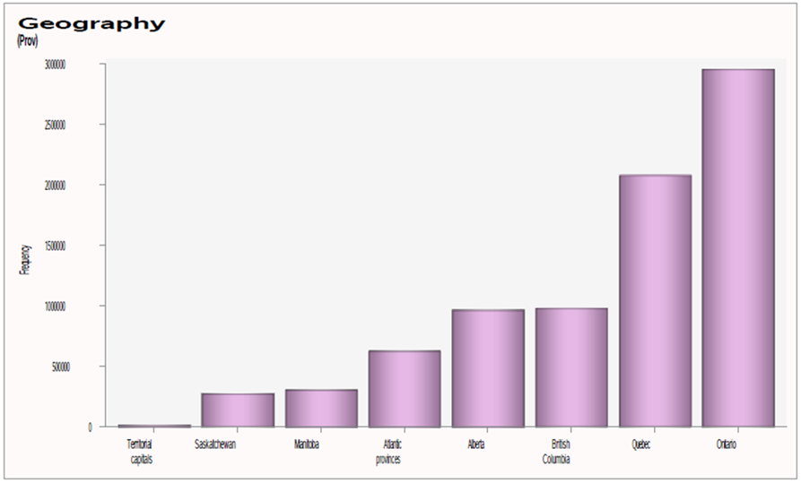
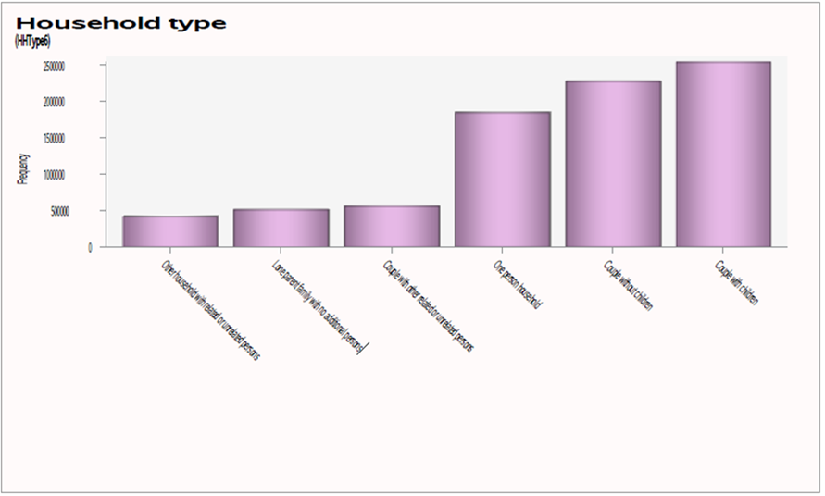
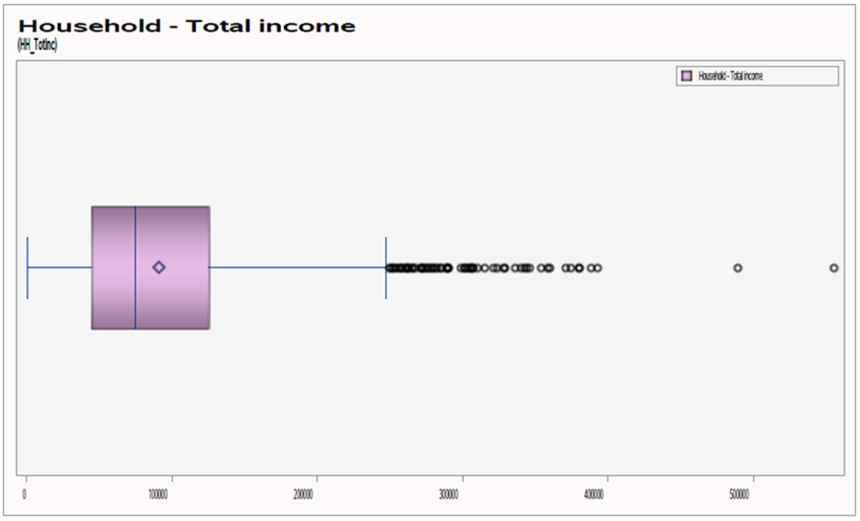
Household

Slide 19
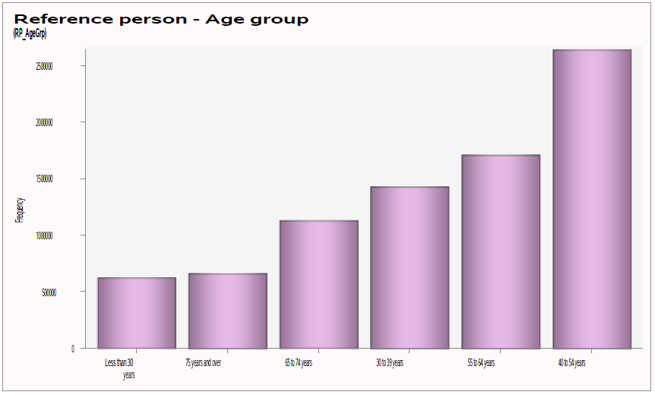
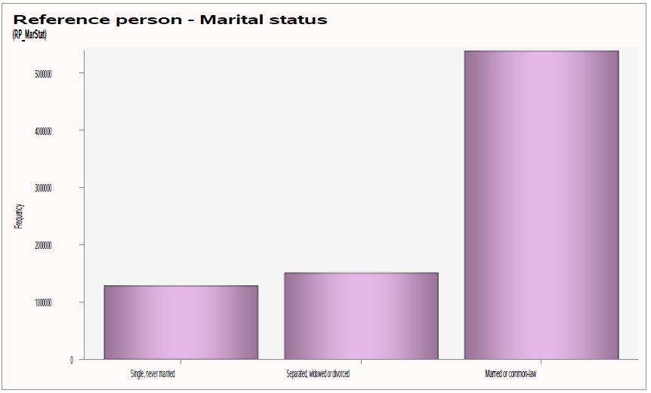
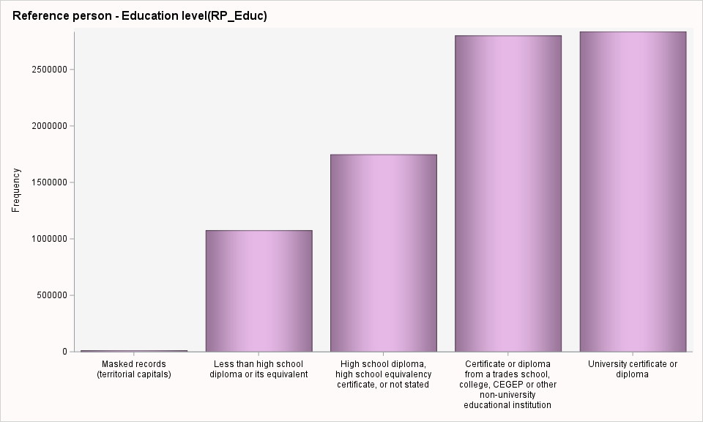
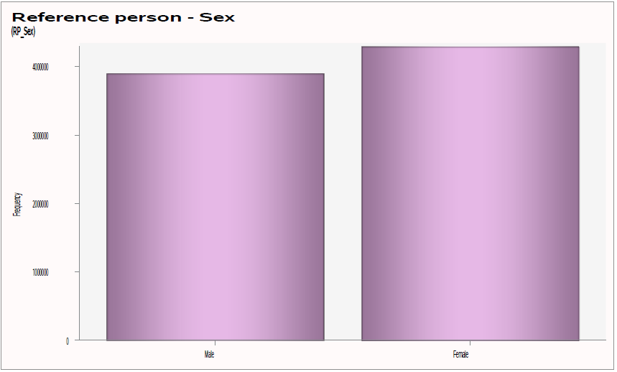
Reference Person

Slide 20
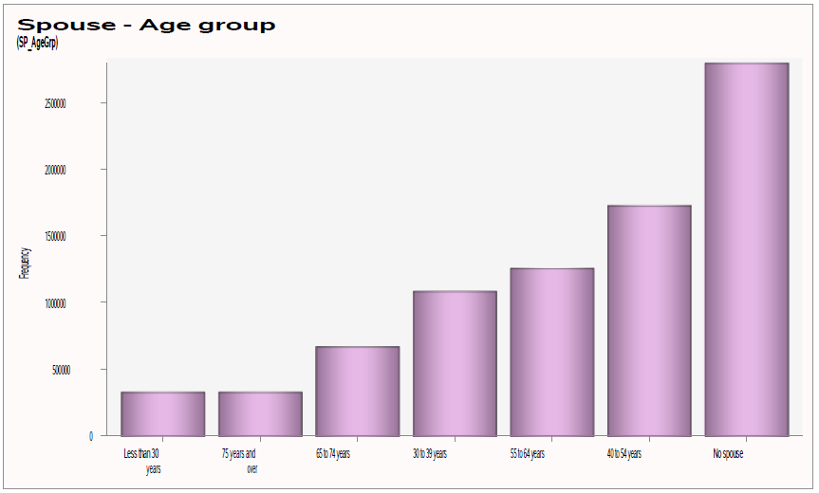
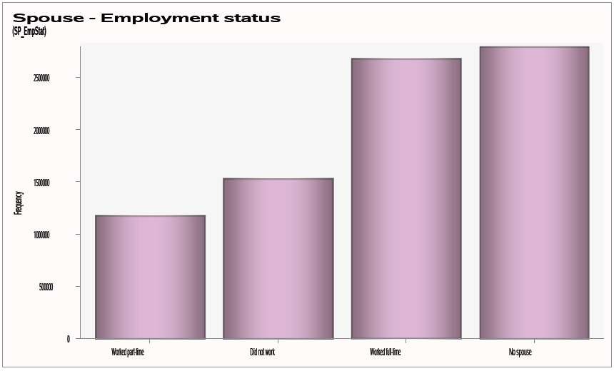
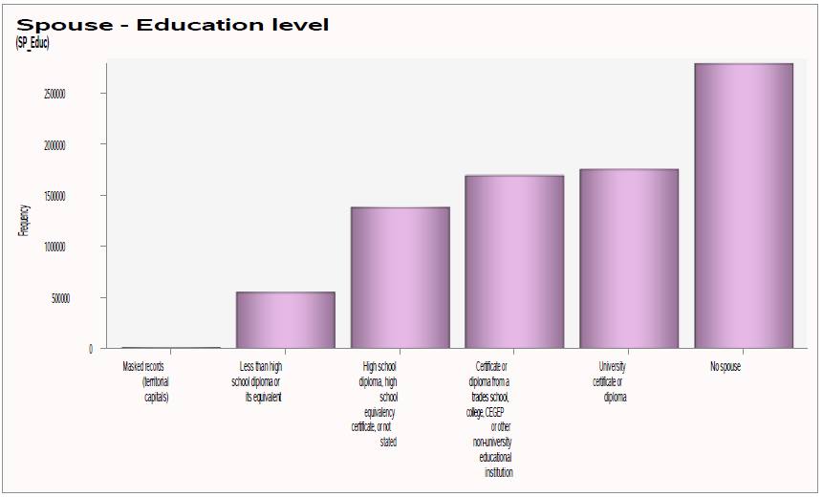
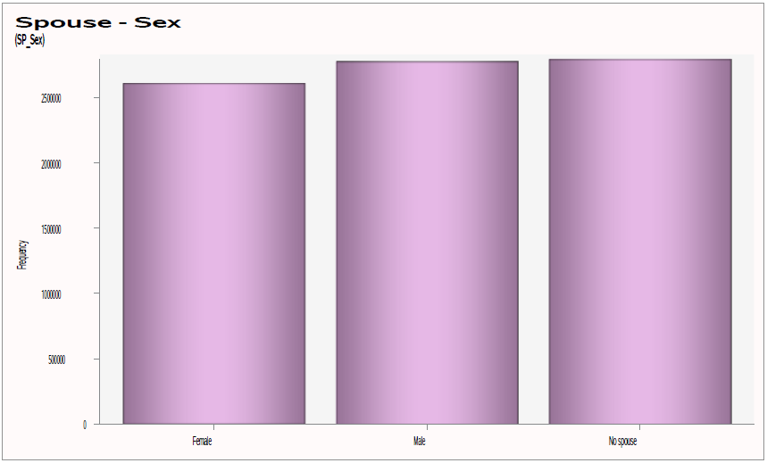
Spouse

Slide 21
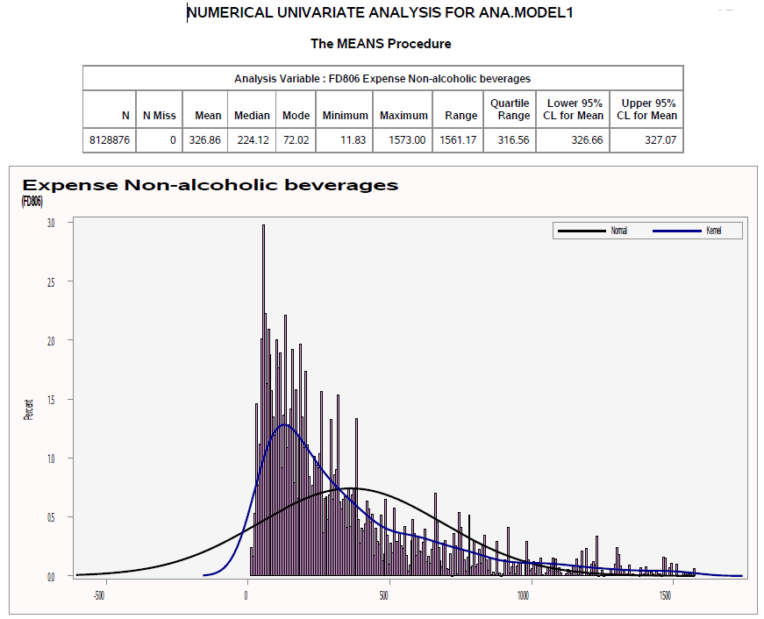
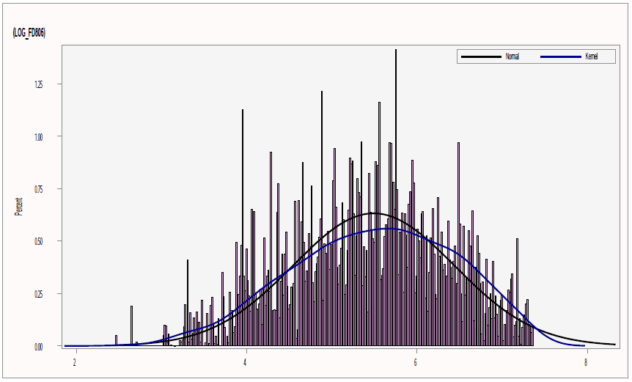
Expense

Slide 22
Bivariate Analysis

Slide 23
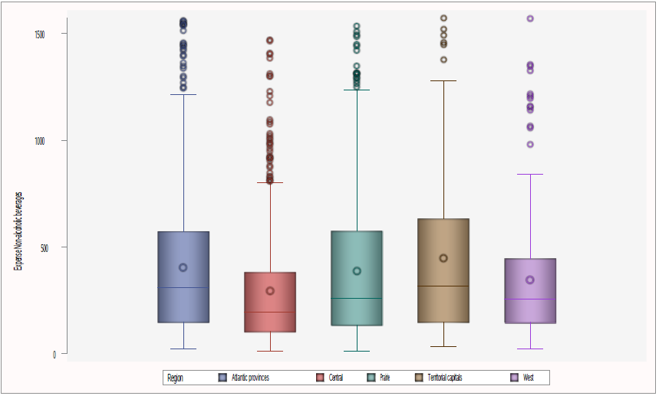
Level | N | Mean | 95% CL (Lower) | 95% CL (Upper) | Skewness | P-value
Atlantic provinces | 629768 | 404.59 | 403.75 | 405.44 | -0.41 | <.0001
Central | 4987062 | 294.35 | 294.1 | 294.59 | -0.07
Prairie | 1530428 | 387.31 | 386.77 | 387.84 | -0.28
Territorial capitals | 11711 | 447.33 | 440.68 | 453.98 | -0.28
West | 969907 | 346.77 | 346.17 | 347.36 | -0.29
Region

Slide 24
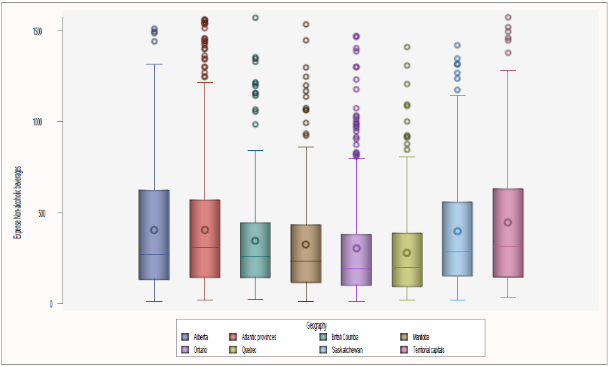
Level | N | Mean | 95% CL (Lower) | 95% CL (Upper) | Skewness | P-value
Alberta | 958697 | 404.36 | 403.65 | 405.06 | -0.29 | <.0001
Atlantic provinces | 629768 | 404.59 | 403.75 | 405.44 | -0.41
British Columbia | 969907 | 346.77 | 346.17 | 347.36 | -0.29
Manitoba | 299857 | 324.21 | 323.17 | 325.24 | -0.23
Ontario | 2882375 | 305.37 | 305.03 | 305.72 | 0.02
Quebec | 2104687 | 279.25 | 278.91 | 279.58 | -0.20
Saskatchewan | 271874 | 396.78 | 395.59 | 397.97 | -0.29
Territorial capitals | 11711 | 447.33 | 440.68 | 453.98 | -0.28
Geography

Slide 25
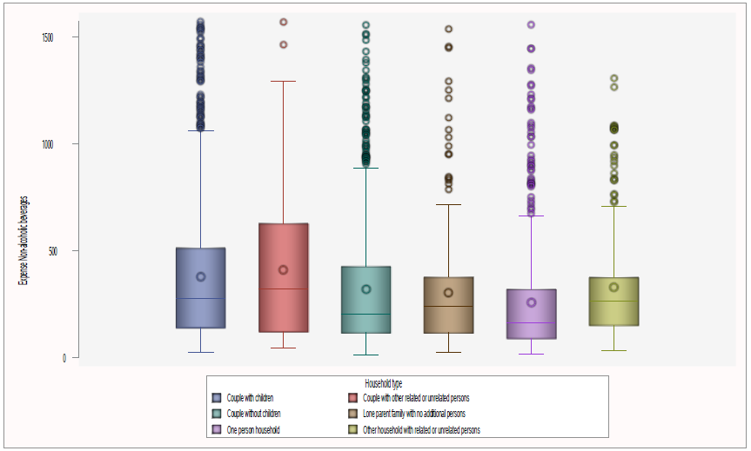
Level | N | Mean | 95% CL (Lower) | 95% CL (Upper) | Skewness | P-value
Couple with children | 2457237 | 377.09 | 376.69 | 377.5 | -0.29 | <.0001
Couple with other related or unrelated persons | 557180 | 409.09 | 408.21 | 409.96 | -0.38
Couple without children | 2206478 | 317.62 | 317.23 | 318 | -0.08
Lone parent family with no additional persons | 513225 | 302.25 | 301.51 | 302.98 | -0.24
One person household | 1964999 | 257.47 | 257.08 | 257.85 | 0.08
Other household with related or unrelated persons | 429757 | 327.27 | 326.48 | 328.06 | -0.35
Household type

Slide 26
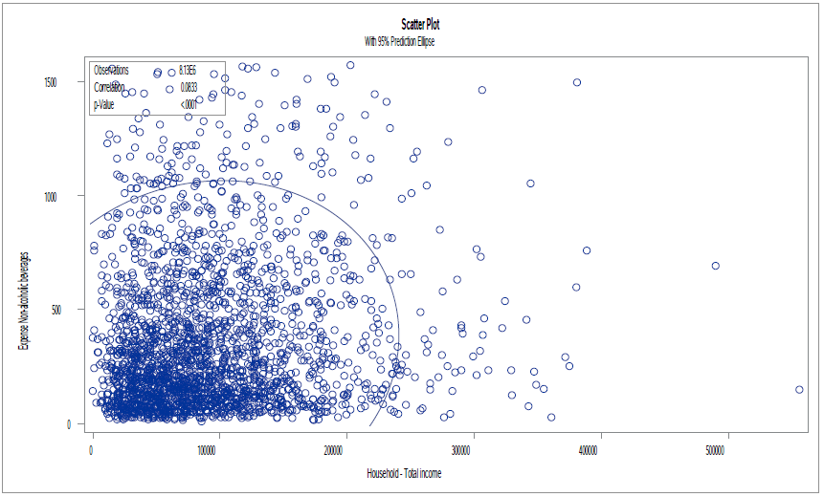
 | Pearson | Spearman
Factor | PERC_EXPENSE | PERC_EXPENSE
HH_TotInc Household - Total income | 0.08326 <.0001 | 0.09047 <.0001
Household - Total income

Slide 27
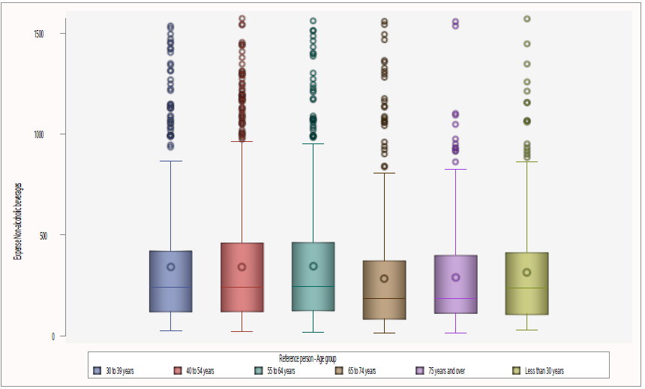
Level | N | Mean | 95% CL (Lower) | 95% CL (Upper) | Skewness | P-value
30 to 39 years | 1399872 | 341.41 | 340.89 | 341.93 | -0.03 | <.0001
40 to 54 years | 2595446 | 341.19 | 340.82 | 341.56 | -0.23
55 to 64 years | 1693126 | 343.97 | 343.49 | 344.44 | -0.14
65 to 74 years | 1124539 | 281.24 | 280.7 | 281.79 | 0.09
75 years and over | 670281 | 287.33 | 286.7 | 287.97 | -0.37
Less than 30 years | 645612 | 313.39 | 312.71 | 314.07 | -0.16
Reference person – Age group

Slide 28
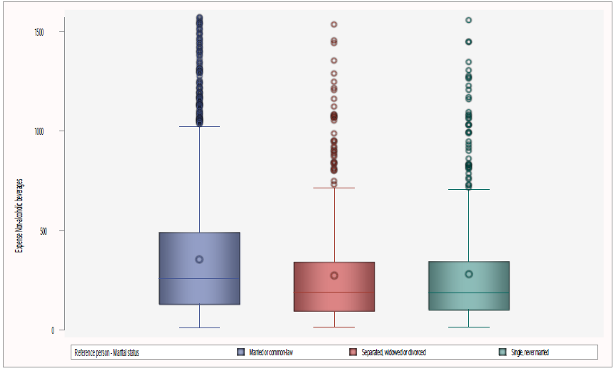
Level | N | Mean | 95% CL (Lower) | 95% CL (Upper) | Skewness | P-value
Married or common-law | 5220895 | 355.37 | 355.1 | 355.64 | -0.20 | <.0001
Separated, widowed or | 1548207 | 272.2 | 271.79 | 272.61 | -0.13
Single, never married | 1359774 | 279.65 | 279.17 | 280.14 | 0.02
Reference person – Marital status

Slide 29
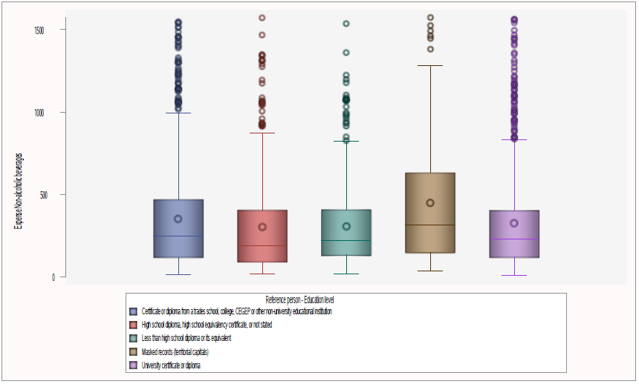
Level | N | Mean | 95% CL (Lower) | 95% CL (Upper) | Skewness | P-value
Certificate or diploma from a trades school, college, CEGEP or other non-university educational institution | 2688986 | 351.14 | 350.76 | 351.53 | -0.18 | <.0001
High school diploma, high school equivalency certificate, or not stated | 1668821 | 302.08 | 301.62 | 302.53 | 0.08
Less than high school diploma or its equivalent | 1043308 | 305.61 | 305.1 | 306.12 | -0.33
Masked records (Territorial capitals) | 11711 | 447.33 | 440.68 | 453.98 | -0.28
University certificate or diploma | 2716050 | 325.7 | 325.35 | 326.06 | -0.22
Reference person - Education level

Slide 30
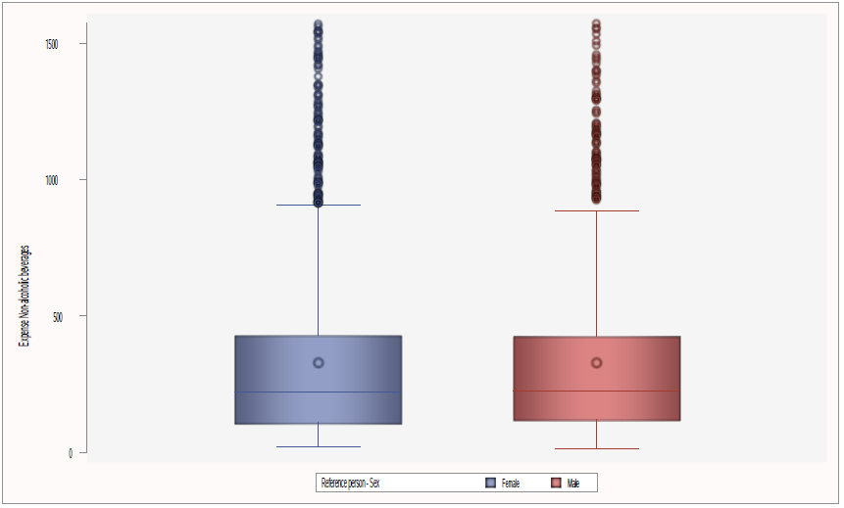
Level | N | Mean | 95% CL (Lower) | 95% CL (Upper) | Skewness |  | P-value
Female | 4262186 | 326.98 | 326.68 | 327.27 |  | -0.08 | <.0001
Male | 3866690 | 326.74 | 326.45 | 327.03 |  | -0.23
Reference person - Sex

Slide 31
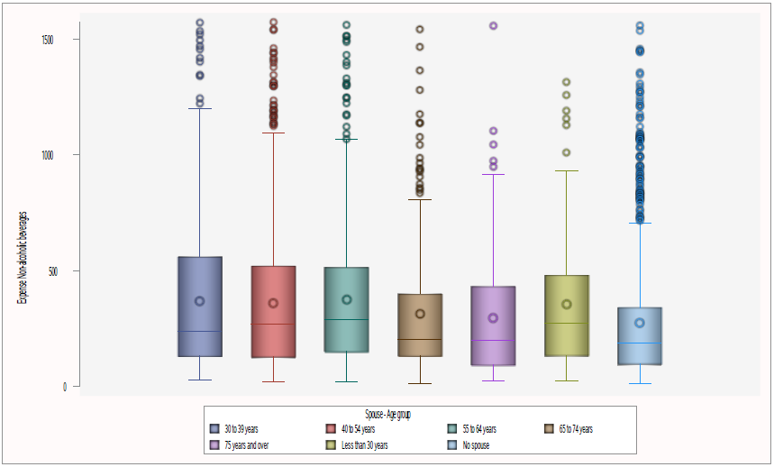
Level | N | Mean | 95% CL (Lower) | 95% CL (Upper) | Skewness | P-value
30 to 39 years | 1029929 | 369.03 | 368.36 | 369.69 | -0.14 | <.0001
40 to 54 years | 1667543 | 360 | 359.53 | 360.46 | -0.19
55 to 64 years | 1237655 | 374.4 | 373.84 | 374.95 | -0.27
65 to 74 years | 642970 | 314.79 | 314.07 | 315.51 | -0.13
75 years and | 329381 | 296.11 | 295.2 | 297.01 | -0.13
Less than 30 | 313417 | 356.29 | 355.24 | 357.34 | -0.44
No spouse | 2907981 | 275.69 | 275.37 | 276 | -0.06
Spouse - Age group

Slide 32
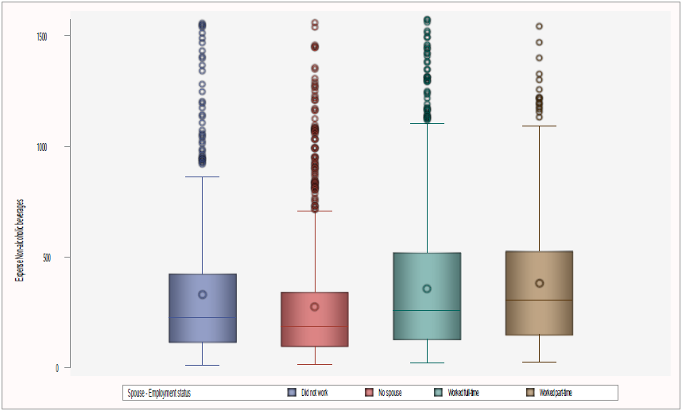
Level | N | Mean | 95% CL (Lower) | 95% CL (Upper) | Skewness | P-value
Did not work | 1453314 | 330.34 | 329.83 | 330.86 | -0.09 | <.0001
No spouse | 2907981 | 275.69 | 275.37 | 276 | -0.06
Worked full-time | 2599458 | 357.87 | 357.49 | 358.25 | -0.22
Worked part-time | 1168123 | 380.96 | 380.4 | 381.52 | -0.28
Spouse - Employment status

Slide 33
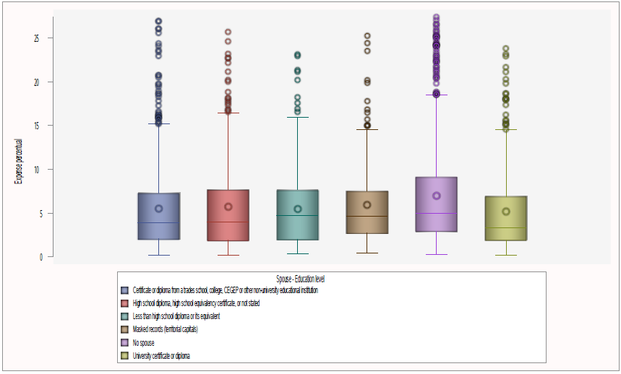
Level | N | Mean | 95% CL (Lower) | 95% CL (Upper) | Skewness | P-value
Certificate or diploma from a trades school, college, CEGEP or other non-university educational institution | 1636840 | 359.03 | 358.56 | 359.5 | -0.29 | <.0001
High school diploma, high school equivalency certificate,or not stated | 1358512 | 366.33 | 365.79 | 366.87 | -0.16
Less than high school diploma or its equivalent | 546094 | 339.5 | 338.73 | 340.27 | -0.46
Masked records (territorial capitals) | 11711 | 447.33 | 440.68 | 453.98 | -0.28
No spouse | 2903242 | 275.52 | 275.21 | 275.84 | -0.06
University certificate or diploma | 1672477 | 347.48 | 347 | 347.97 | -0.07
Spouse - Education level

Slide 34
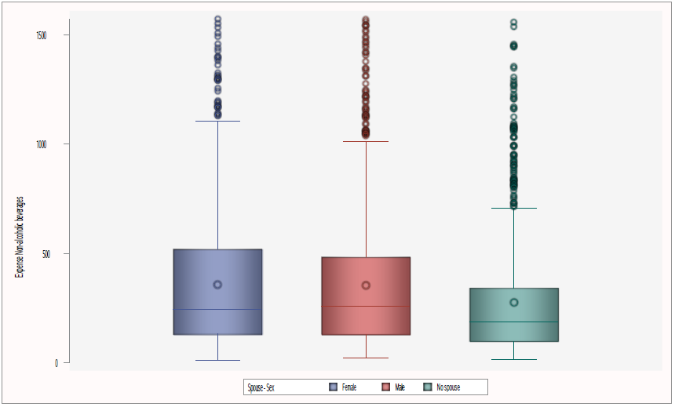
Level | N | Mean | 95% CL (Lower) | 95% CL (Upper) | Skewness | P-value
Female | 2493849 | 357.82 | 357.43 | 358.21 | -0.22 | <.0001
Male | 2727046 | 353.13 | 352.76 | 353.51 | -0.19
No spouse | 2907981 | 275.69 | 275.37 | 276 | -0.06
Spouse - Sex

Slide 35
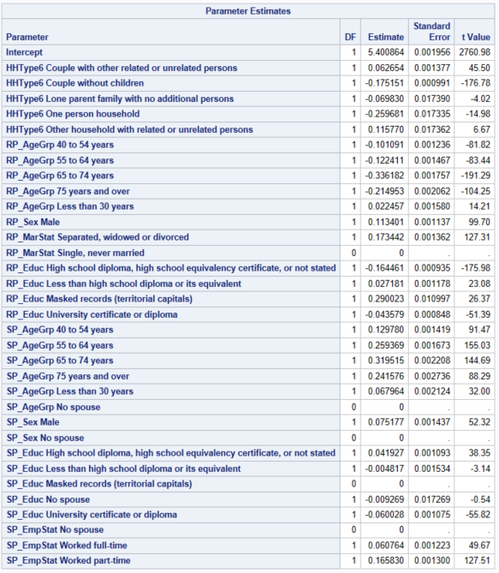
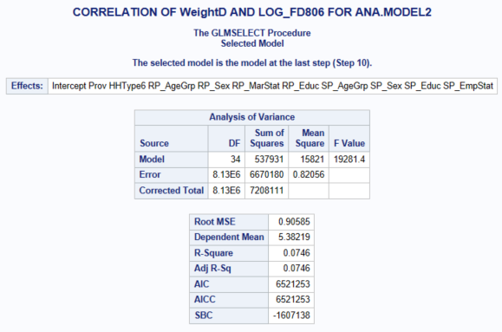
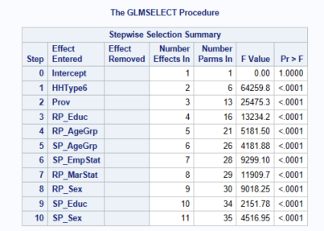
Model

Slide 36
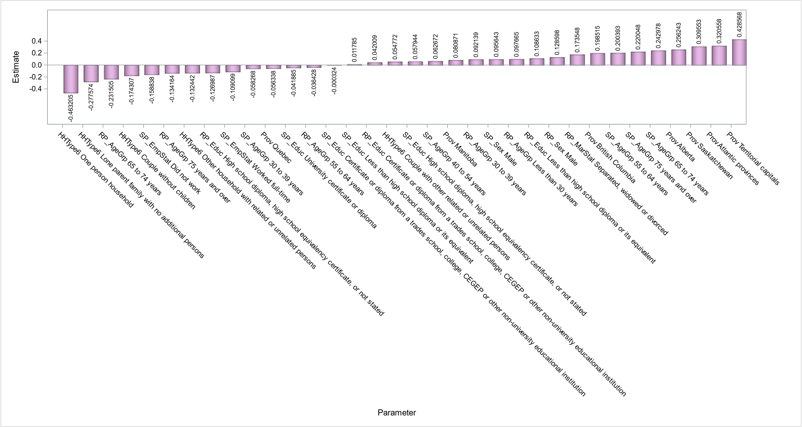
Parameters

Slide 37
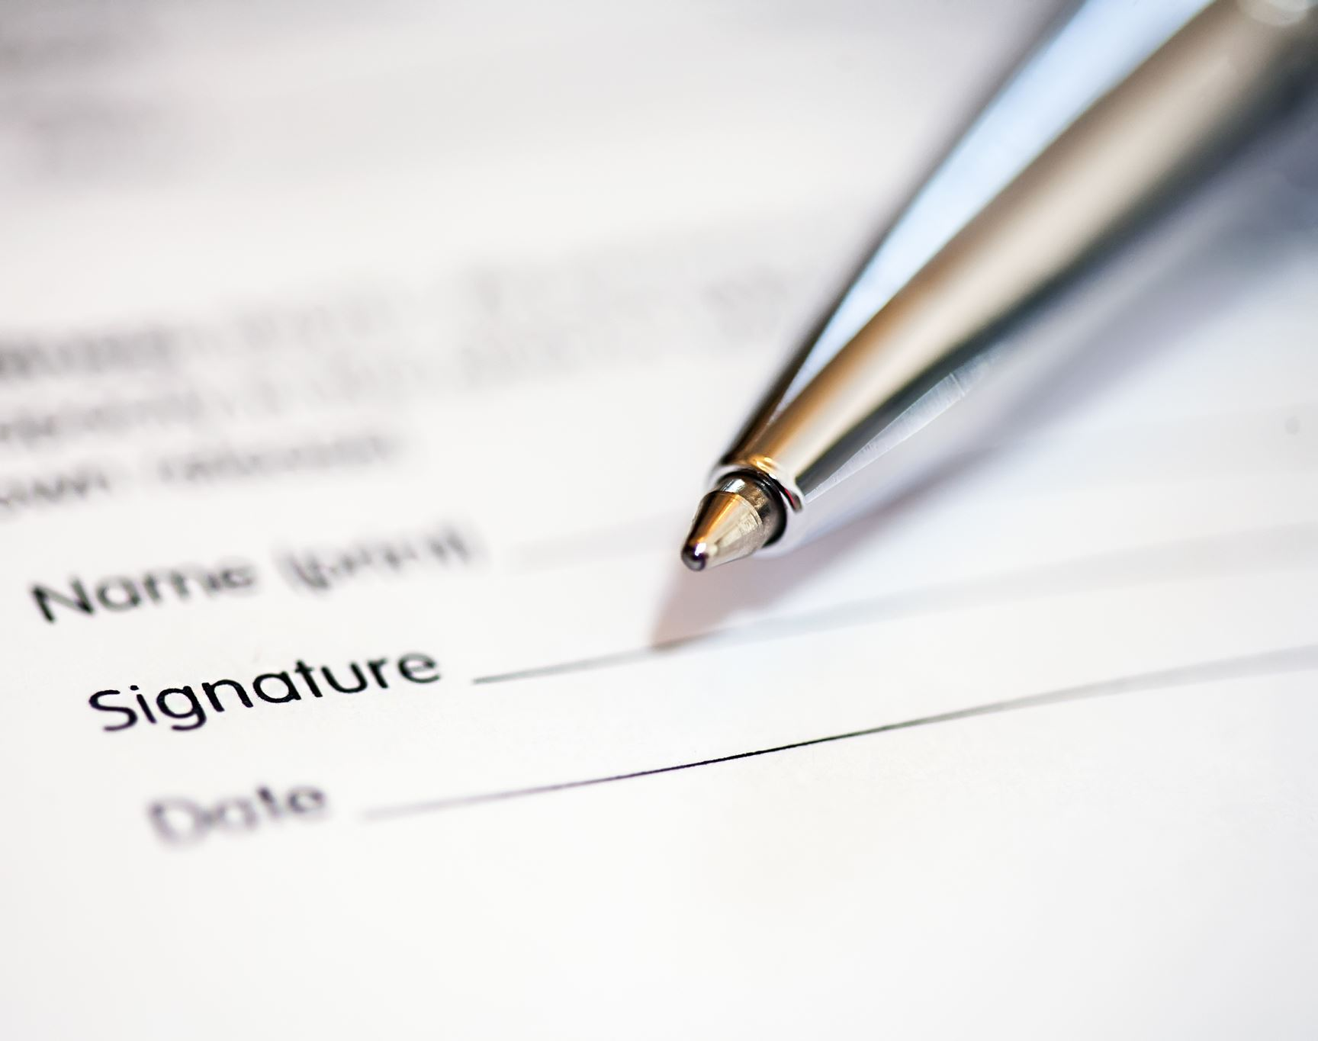
Conclusions and Recommendations

Slide 38
Which product expense is the biggest regarding store purchase?(target)
Non-alcoholic beverages is the expense that weighs the most on store purchases.
Is the expense diverse regarding geography (Region and Province)?
Yes. All groups have different expense behaviour with Territorial capitals having the biggest mean expense despite having the smallest population.
Is the expense diverse regarding Household Type?
Yes. All groups have different expense behaviour with households having Couple with other related or unrelated person having the biggest mean.

Slide 39
Does higher Household Income mean higher expense?
No. There is little to no association between Income and Expense on non-alcoholic beverages.
What impacts the expense of the previously identified product?
We see that residents of Territorial capitals have the biggest expense and households with only one person have the smallest despite being a meaningful proportion of the population.

Slide 40
To maintain revenue, special attention should be applied for stock keeping and market to retain consumers in areas with higher concentration of:
Households with Couple with other related or unrelated persons
Households with Couple with children
Males
Separated, widowed or divorced
Households with couples that both have Less than high school diploma or its equivalent
And due to larger population of consumers: Ontario Province.
Customize products: flavours, package themes
Target advertisement

Slide 41
To increase sales, target promotions to acquire consumers and increase spending of existing ones in areas with higher concentration of:
One person households
Households with couples with a combination of age group of with more than 65 years and over and spouse within 30 to 39 years
And due to larger population of consumers: Quebec Province.
Customize products: package size
Target advertisement
Next Steps
Territorial capitals (biggest expected expense) x Quebec (smallest expected expense)
- Is the price, availability, product characteristics or culture that motivates these regions to such contrast spending with non-alcoholic beverages?

Slide 42
Questions?
Thank You!
anaclarat@womenindata.ca

Slide 43
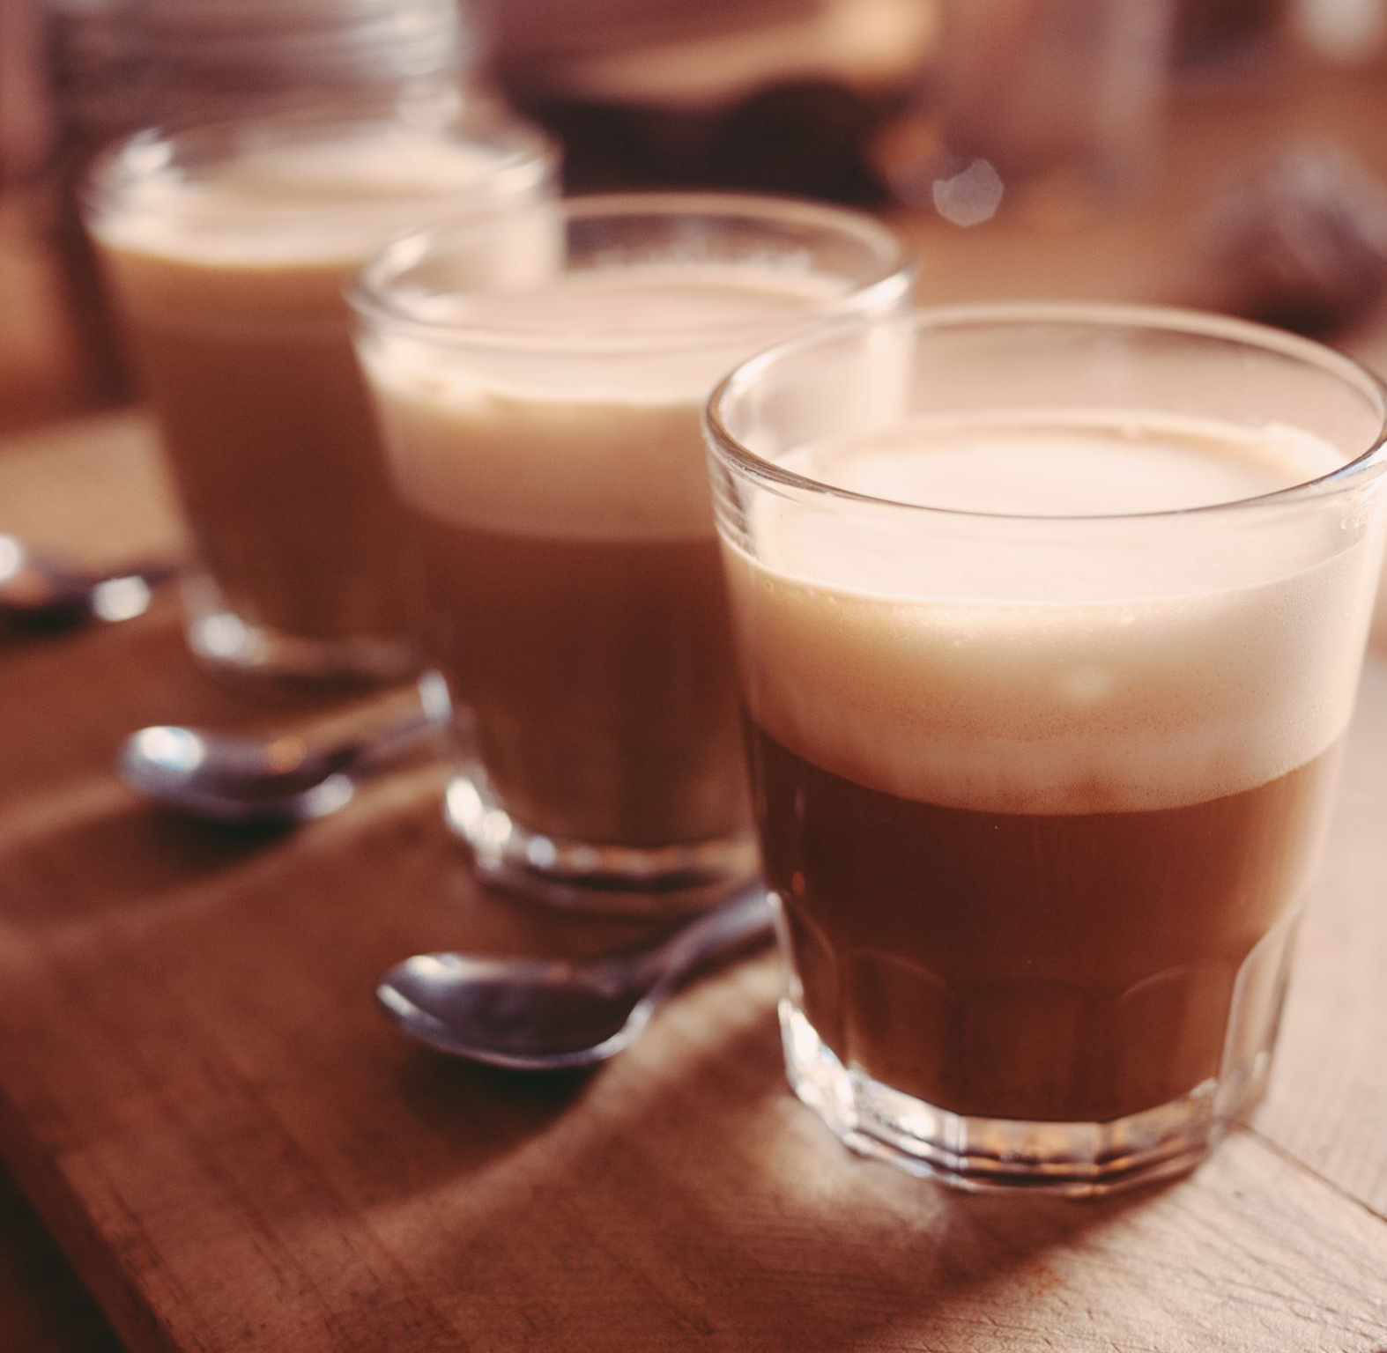
Appendix
SAS Script/Extra graphs

Slide 44
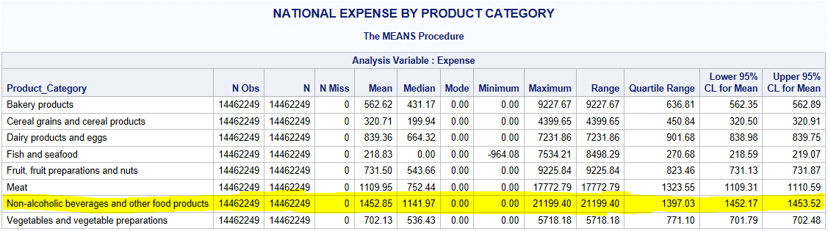
Tabular summaries

Slide 45


Slide 46


Slide 47



Slide 48











Bivariate After log transformation

Slide 49






Which groups are different?

Slide 50





T-test for RP_Sex

Slide 51
Script
LIBNAME ANA "D:\1_Metro College\Courses\DSP-SAS\Project";
********************************************************** SAS Macros ***************************************************;
PROC OPTIONS OPTION = MACRO;
RUN;
ODS GRAPHICS ON;
/*Auxiliar Information*/
*T-test - Road map:;
DATA TESTT;
INPUT @1 TEXT $CHAR125.;
INFILE DATALINES TRUNCOVER;
DATALINES;
Null hypothesis: There’s no difference in means
Assumptions:
1.Sample distribution must be normal:
e.g:Shapiro (null hypothesis: sample has a normal distribution)
CLT :
a.If it looks normal and each group have more than 30 observations
b.If moderately skewed, each group must have more than 100 observations
2.Groups are independent of one another.
3.There are no major outliers.
4.A check for unequal variances will help determine which version of an independent samples t-test is most appropriate:
(e.g:Levene’s test, null hypothesis: equal variances)
a.If variances are equal, then a pooled t-test is appropriate
b.If variances are unequal, then a Satterthwaite (also known as Welch’s) t-test is appropriate
;
RUN;
DATA TEST_ANOVA;
INPUT @1 TEXT $CHAR125.;
INFILE DATALINES TRUNCOVER;
DATALINES;
One-way ANOVA Assumptions
In order to run a one-way ANOVA the following assumptions must be met:
1.The response of interest is continuous and normally distributed for each treatment group:
Normality test: PROC UNIVARIATE NORMAL and QQPlot for each group.
2.Treatment groups are independent of one another. Experimental units only receive one treatment,and they do not overlap.
3.There are no major outliers.
4.A check for unequal variances will help determine which version of a one-way ANOVA is most appropriate
(Levene’s test, Null hypothesis: variances are equal between groups):
A .If variances are equal, then the assumptions of a standard one-way ANOVA are met.
B. If variances are unequal, then a Welch’s one-way ANOVA is appropriate.
;

Slide 52
*Levene’s test:;
DATA LEVENE;
INPUT @1 TEXT $CHAR125. ;
INFILE DATALINES TRUNCOVER;
DATALINES;
Null hypothesis: equal variances
a.If variances are equal, then a pooled t-test is appropriate
b.If variances are unequal, then a Satterthwaite (also known as Welch’s) test is appropriate
;
RUN;
DATA SHAPIRO;
INPUT @1 TEXT $CHAR140.;
INFILE DATALINES TRUNCOVER;
DATALINES;
Normal Distribution?
Null hypothesis: sample has a normal distribution
CLT :
a.If it looks normal and each group have more than 30 observations
b.If moderately skewed, each group must have more than 100 observations
*rule of thumb: If skewness is between -1 and -0.5 or between 0.5 and 1, the distribution is moderately skewed.
*if the sample size is over 2000, the Kolmgorov test should be used. If the sample size is less than 2000, the Shapiro test is better.
;
RUN;
DATA TESTT1;
INPUT TEXT $160.;
DATALINES;
"Null hypothesis: There’s no difference in means"
;
RUN;
DATA CHI;
INPUT TEXT $140.;
DATALINES;
Chi – square (Road Map and Assumptions):
If condition of chi-square are satisfied and p-value is less than significant level (5%) reject null hypothesis:
There is a relationship between variables at the defined significant level.
Null hypothesis: Variables are independents.
1. N, the total frequency, should be reasonably large (greater than 50)
2. The sample observations should be independent. No individual item should be included twice or more in the sample
3. No expected frequencies should be small. Preferably each expected frequency should be larger than 10 but in any case not less than 5.
;
RUN;

Slide 53
DATA CORR;
INPUT TEXT $160.;
DATALINES;
Null hypothesis: there’s no association between variables.
1.Normal distribution for both variables for pearson
2.homoscedasticity assumes that data is equally distributed about the regression line.
3.Linear:
Linear: pearson
Monotonically related (not normal): spearman kendall hoeffding
;
RUN;
/*UNIVARIATE*/
%MACRO EDA(DATA,WEIGHT=,ALPHA=,OUTPUT_FILE_PATH=);
*PDF PAGE CONFIGURATION;
options orientation=landscape;
ods listing close;
*gRAPH SIZE;
ODS GRAPHICS / HEIGHT=12CM WIDTH=20CM;
*CHECK IF A ALPHA VALUE WAS INFORMED;
%IF %SUPERQ(ALPHA) NE %STR() %THEN %LET ALPHA= &ALPHA; %ELSE %LET ALPHA = 0.05;
*SEPARATING CATEGORICAL AND NUMERICAL VALUES;
PROC CONTENTS DATA = &DATA. OUT= &DATA._PROJECT_VARS;RUN;
PROC SQL;
SELECT NAME INTO: NUM_ONLY SEPARATED BY " "
FROM &DATA._PROJECT_VARS
WHERE TYPE EQ 1
;
SELECT NAME INTO : CHAR_ONLY SEPARATED BY " "
FROM &DATA._PROJECT_VARS
WHERE TYPE EQ 2
;
QUIT;
/*************************NUMERICAL ANALYSIS **********************/
%LET N1 = %SYSFUNC(COUNTW(&NUM_ONLY));
%DO I1 = 1 %TO &N1;
%LET VAR = %SCAN(&NUM_ONLY,&I1);

Slide 54
*EXTRACTING LABEL;
DATA DEM2 ;
SET &DATA.;
KEEP &VAR.;
RUN;
proc sql
noprint;
select label into: label1
from dictionary.columns
where libname = 'WORK' and memname = 'DEM2';
/* libname and memname values must be upper case */
quit;
***********************************************************;
ODS PDF FILE = "&OUTPUT_FILE_PATH.\&DATA._PROFILING_&VAR._&SYSDATE9..PDF" STARTPAGE=NO UNIFORM;
***********************************************************;
TITLE "NUMERICAL UNIVARIATE ANALYSIS FOR &DATA";
PROC MEANS DATA=&DATA N NMISS MEAN MEDIAN MODE MIN MAX RANGE QRANGE CLM MAXDEC=2 ALPHA = &ALPHA;
FREQ &WEIGHT;
VAR &VAR;RUN;
PROC SGPLOT DATA=&DATA;
TITLE J=LEFT "&LABEL1.(&VAR.)";
HISTOGRAM &VAR / FILLATTRS =(COLOR = PLUM) DATASKIN=PRESSED FREQ=&WEIGHT;
DENSITY &VAR/ LINEATTRS = (COLOR = BLACK);
DENSITY &VAR/TYPE = KERNEL LINEATTRS = (COLOR = DARKBLUE) ;
STYLEATTRS
BACKCOLOR = SNOW
WALLCOLOR = WHITESMOKE;
KEYLEGEND / LOCATION = INSIDE POSITION = TOPRIGHT;
XAXIS DISPLAY=(NOLABEL);
RUN;
PROC SGPLOT DATA=&DATA;
TITLE J=LEFT "&LABEL1.(&VAR.)";
HBOX &VAR / FILLATTRS =(COLOR = PLUM) DATASKIN=PRESSED FREQ=&WEIGHT;
STYLEATTRS
BACKCOLOR = SNOW
WALLCOLOR = WHITESMOKE;
KEYLEGEND / LOCATION = INSIDE POSITION = TOPRIGHT;
XAXIS DISPLAY=(NOLABEL);
RUN;
QUIT;
TITLE;
RUN;
ODS PDF CLOSE;
%END;

Slide 55
/***********************CATEGORICAL ANALYSIS******************/
%LET N2 = %SYSFUNC(COUNTW(&CHAR_ONLY));
%DO I2 = 1 %TO &N2;
%LET VAR = %SCAN(&CHAR_ONLY,&I2);
***********************************************************;
*EXTRACTING LABEL;
DATA DEM2 ;
SET &DATA.;
KEEP &VAR.;
RUN;
proc sql
noprint;
select label into: label1
from dictionary.columns
where libname = 'WORK' and memname = 'DEM2';
/* libname and memname values must be upper case */
quit;
***********************************************************;
ODS PDF FILE = "&OUTPUT_FILE_PATH.\&DATA._PROFILING_&VAR._&SYSDATE9..PDF" STARTPAGE=NO UNIFORM;
***********************************************************;
TITLE "CATEGORICAL UNIVARIATE ANALYSIS FOR &DATA";
PROC FREQ DATA=&DATA NLEVELS ;
TABLE &VAR / MISSING;
WEIGHT &WEIGHT;
RUN;
PROC SGPLOT DATA = &DATA ;
TITLE J=LEFT "&LABEL1.(&VAR.)";
VBAR &VAR / CATEGORYORDER=RESPASC FREQ= &WEIGHT
FILLATTRS=(COLOR = PLUM)
DATASKIN=pressed;
STYLEATTRS
BACKCOLOR=snow
WALLCOLOR=WhiteSmoke
AXISEXTENT= DATA
;
XAXIS DISPLAY=(NOLABEL);
RUN;
TITLE;
QUIT;
ODS PDF CLOSE;
%END;
%MEND EDA ;

Slide 56
/*BIVARIATE*/
%MACRO BIVAR_CAT_CONT(DATA,VAR,ALPHA,WEIGHT=,OUTPUT_FILE_PATH= )/minoperator;
*PDF PAGE CONFIGURATION;
options orientation=landscape;
ods listing close;
*GRAPH SIZE;
ODS GRAPHICS / HEIGHT=12CM WIDTH=20CM;
*CHECK IF A ALPHA VALUE WAS INFORMED;
%IF %SUPERQ(ALPHA) NE %STR() %THEN %LET ALPHA= &ALPHA; %ELSE %LET ALPHA = 0.05;
*SEPARATING CATEGORICAL AND NUMERICAL VALUES;
PROC CONTENTS DATA = &DATA. OUT= &DATA._PROJECT_VARS;RUN;
PROC SQL;
SELECT NAME INTO: NUM_ONLY SEPARATED BY " "
FROM &DATA._PROJECT_VARS
WHERE TYPE EQ 1
;
SELECT NAME INTO : CHAR_ONLY SEPARATED BY " "
FROM &DATA._PROJECT_VARS
WHERE TYPE EQ 2
;
QUIT;
/*CATEGORICAL VARIABLES*/
%LET N2 = %SYSFUNC(COUNTW(&CHAR_ONLY));
%DO I2 = 1 %TO &N2;*CATEGORICAL IF;
%LET CLASS = %SCAN(&CHAR_ONLY,&I2);
***********************************************************;
*EXTRACTING LABEL -CAT;
DATA DEM2 ;
SET &DATA.;
KEEP &CLASS.;
RUN;
proc sql
noprint;
select label into: LABEL_CAT
from dictionary.columns
where libname = 'WORK' and memname = 'DEM2';
/* libname and memname values must be upper case */
quit;
*EXTRACTING LABEL -CONT;
DATA DEM3 ;
SET &DATA.;
KEEP &VAR.;
RUN;

Slide 57
proc sql
noprint;
select label into: LABEL_CONT
from dictionary.columns
where libname = 'WORK' and memname = 'DEM3';
/* libname and memname values must be upper case */
quit;
***********************************************************;
ODS PDF FILE = "&OUTPUT_FILE_PATH.\&DATA._BIVARIATE_&CLASS._AND_&VAR._&SYSDATE9..PDF" STARTPAGE=NO UNIFORM;
***********************************************************;
TITLE "BIVARIATE ANALYSIS OF &CLASS. AND &VAR. FOR &DATA";
PROC SORT DATA = &DATA;
BY &CLASS; RUN;
/*This presents summary for bivariate analysis*/
%LET N = %SYSFUNC(COUNTW(&VAR));
%DO I = 1 %TO &N;
%LET X = %SCAN(&VAR,&I);
PROC MEANS DATA = &DATA. N NMISS MIN Q1 MEDIAN MEAN Q3 MAX QRANGE CV CLM SKEW MAXDEC=2 ALPHA = &ALPHA ;
FREQ &WEIGHT;
TITLE2 " RELATION BETWEEN &X. AND &CLASS.";
CLASS &CLASS. ;
VAR &X.;
OUTPUT OUT= OUT_&CLASS._&X. MIN = MEAN= STD = MAX = /AUTONAME ;
RUN;
%END;
TITLE;TITLE2; RUN;
/*This presents visual for bivariate analysis*/
*BOXPLOT;
PROC SGPLOT DATA=&DATA;
TITLE J=LEFT " RELATION BETWEEN &X. AND &CLASS.";
VBOX &VAR/ GROUP = &CLASS DATASKIN=pressed FREQ=WEIGHTD;
STYLEATTRS
BACKCOLOR=snow
WALLCOLOR=WhiteSmoke
AXISEXTENT= DATA ;
RUN;
QUIT;
*HISTOGRAM;
/*PROC SGPANEL DATA=&DATA;*/
/* PANELBY &CLASS. / layout=COLUMNLATTICE ONEPANEL NOVARNAME;*/
/* HISTOGRAM &VAR. / DATASKIN=PRESSED FILLATTRS=(COLOR = PLUM);*/
/*RUN;*/

Slide 58
/*This presents test of independency for bivariate analysis*/
/*How many levels has CLASS variable?*/
PROC SQL NOPRINT;
SELECT COUNT(DISTINCT &CLASS.) INTO: LEVELS
FROM &DATA.
QUIT;
*CONDUCT T-TEST IF CAT HAS 2 LEVELS;
%IF &LEVELS. EQ 2 %THEN %DO;
TITLE "T-test - Road map:";
PROC REPORT DATA = TESTT NOWINDOWS NOHEADER NOCENTER
STYLE(COLUMN) = { BACKGROUND= NONE }; RUN;
TITLE1;
/*Normality check*/
TITLE "THIS IS FOR NORMALITY CHECK OF &VAR. AND &CLASS";
proc report data= SHAPIRO nowindows noheader nocenter
style(column) = { background = NONE }; RUN;
TITLE1;TITLE2;
PROC UNIVARIATE DATA=&DATA NORMAL ALPHA=&ALPHA;
FREQ &WEIGHT;
VAR &VAR;
*pLOTS WERE COMMENTED BECAUSE OF COMPUTATIONAL POWER;
*QQPLOT / NORMAL(MU=EST SIGMA=EST) SQUARE ;
/*HISTOGRAM / NORMAL(COLOR=(RED BLUE) mu= est sigma= est);*/
BY &CLASS;
RUN;
/*Variance check*/
TITLE "THIS IS FOR VARIANCE CHECK OF &VAR. AND &CLASS";
TITLE2 "Levene’s test";
proc report data= LEVENE nowindows noheader nocenter
style(column) = { background = NONE }; RUN;
TITLE1;TITLE2;
PROC GLM data=&DATA ALPHA=&ALPHA PLOTS=NONE;
CLASS &CLASS;
FREQ &WEIGHT;
MODEL &VAR = &CLASS;
MEANS &CLASS / hovtest=levene(type=abs) WELCH ALPHA=&ALPHA;
RUN;
QUIT;

Slide 59
/*TTEST*/
TITLE "THIS IS FOR TTEST OF &VAR. AND &CLASS";
TITLE2 "Levene’s test";
proc report data= TESTT1 nowindows noheader nocenter
style(column) = { background = NONE }; RUN;
TITLE1;
PROC TTEST DATA = &DATA ALPHA=0.05 PLOTS(ONLY)=SUMMARY;*(UNPACK);
VAR &VAR;
CLASS &CLASS;
FREQ &WEIGHT;
RUN;
%END;
%ELSE %DO;*CONDUCT ANOVA IF CAT HAS MORE THAN 2 LEVELS;
TITLE "Anova - Roadmap";
PROC REPORT DATA = TEST_ANOVA NOWINDOWS NOHEADER NOCENTER
STYLE(COLUMN) = { BACKGROUND= NONE }; RUN;
TITLE1;
/*Normality check*/
TITLE "THIS IS FOR NORMALITY CHECK OF &VAR. AND &CLASS";
proc report data= SHAPIRO nowindows noheader nocenter
style(column) = { background = NONE }; RUN;
TITLE1;TITLE2;
PROC UNIVARIATE DATA=&DATA NORMAL ALPHA=&ALPHA;
FREQ &WEIGHT;
VAR &VAR;
*pLOTS WERE COMMENTED BECAUSE OF COMPUTATIONAL POWER;
*QQPLOT / NORMAL(MU=EST SIGMA=EST) SQUARE ;
/*HISTOGRAM / NORMAL(COLOR=(RED BLUE) mu= est sigma= est);*/
BY &CLASS;
RUN;
/*Variance check*/
TITLE "THIS IS FOR ANOVA AND VARIANCE CHECK OF &VAR. AND &CLASS";
TITLE2 "Levene’s test";
proc report data= LEVENE nowindows noheader nocenter
style(column) = { background = NONE }; RUN;
TITLE1;TITLE2;

Slide 60
*******************************************************************;
/* https://www.google.com/url?sa=t&rct=j&q=&esrc=s&source=web&cd=&ved=2ahUKEwiH7PaNjKf0AhWEZzABHaZiDXEQFnoECBgQAQ&url=https%3A%2F%2Fsupport.sas.com%2Fresources%2Fpapers%2Fproceedings%2Fproceedings%2Fsugi24%2FStats%2Fp264-24.pdf&usg=AOvVaw0bommMFk3-gjL7Yx5fwExW
*"For unequal sample sizes, the confidence coefficient is greater than 1 - a.
*In other words,
the Tukey method is conservative when there are unequal sample sizes."
https://en.wikipedia.org/wiki/Tukey%27s_range_test
*Tukey's assumptions:
The observations being tested are independent within and among the groups.
The groups associated with each mean in the test are normally distributed.
There is equal within-group variance across the groups associated with each
mean in the test (homogeneity of variance). */
PROC GLM data=&DATA ALPHA=&ALPHA PLOTS(ONLY)= CONTROLPLOT;
CLASS &CLASS;
FREQ &WEIGHT;
MODEL &VAR = &CLASS;
MEANS &CLASS / hovtest=levene(type=abs) WELCH CLDIFF ALPHA=&ALPHA;*balanced one-way;
LSMEANS &CLASS /PDIFF ADJUST=TUKEY PLOT = MEANPLOT(CONNECT CL) LINES ALPHA=&ALPHA;*unbalanced one-way;
RUN;
QUIT;
%END;
ODS PDF CLOSE;
%END; *CATEGORICAL IF;
/*NUMERICAL VARIABLES*/
*EXTRACTING LABEL -CONT;
DATA DEM3 ;
SET &DATA.;
KEEP &VAR.;
RUN;
proc sql
noprint;
select label into: LABEL_CONT
from dictionary.columns
where libname = 'WORK' and memname = 'DEM3';
/* libname and memname values must be upper case */
quit;
%LET N3 = %SYSFUNC(COUNTW(&NUM_ONLY));
%DO I3 = 1 %TO &N3;*NUMERICAL IF;
%LET VAR1 = %SCAN(&NUM_ONLY,&I3);
%IF %SUPERQ(VAR1) NE %SUPERQ(VAR) %THEN %DO ;*VERIFY VAR AND VAR1;

Slide 61
***********************************************************;
*EXTRACTING LABEL -CAT;
DATA DEM2 ;
SET &DATA.;
KEEP &VAR1.;
RUN;
proc sql
noprint;
select label into: LABEL_CAT
from dictionary.columns
where libname = 'WORK' and memname = 'DEM2';
/* libname and memname values must be upper case */
quit;
***********************************************************;
ODS PDF FILE = "&OUTPUT_FILE_PATH.\&DATA._BIVARIATE_&VAR._AND_&VAR1._&SYSDATE9..PDF" STARTPAGE=NO UNIFORM;
***********************************************************;
TITLE "BIVARIATE ANALYSIS OF &VAR1. AND &VAR. FOR &DATA";
proc report data= CORR nowindows noheader nocenter
style(column) = { background = NONE }; RUN;
TITLE1;TITLE2;
TITLE "CORRELATION OF &VAR1 AND &VAR. FOR &DATA";
PROC CORR DATA = &DATA PEARSON SPEARMAN PLOTS= (SCATTER MATRIX(HISTOGRAM));
TITLE "CORRELATION OF &VAR1 AND &VAR. FOR &DATA";
VAR &VAR1. &VAR.;
FREQ &WEIGHT.;
RUN;
ODS PDF CLOSE;
%END; *NUMERICAL IF;
%END;*VERIFY VAR AND VAR1;
%MEND BIVAR_CAT_CONT;
*DUMMY VARIABLES;
*SOURCE: https://blogs.sas.com/content/iml/2020/08/31/best-generate-dummy-variables-sas.html;
/* define a macro to create dummy variables */
%macro DummyVars(DSIn, /* the name of the input data set */
VarList, /* the names of the categorical variables */
DSOut); /* the name of the output data set */
/* 1. add a fake response variable */
data AddFakeY / view=AddFakeY;
set &DSIn;
_Y = 0; /* add a fake response variable */
run;
/* 2. Create the design matrix. Include the original variables, if desired */
proc glmselect data=AddFakeY NOPRINT outdesign(addinputvars)=&DSOut(drop=_Y);
class &VarList;
model _Y = &VarList / noint selection=none;
run;
%mend;

Slide 62
********************************************************** Beginning of Analysis **************************************************************************;
* LOADING DATA;
PROC IMPORT OUT = ANA.DEM
DATAFILE = "D:\1_Metro College\Courses\DSP-SAS\HouseHolding Spending\Data\SHS_EDM_2017-eng\SHS_EDM_2017\Data - Données\CSV\SHS-62M004X-E-2017-Diary_F1.csv"
DBMS = CSV
REPLACE;
GETNAMES =YES;
DATAROW=2;
GUESSINGROWS=300;
RUN;
*DATA PROFILING;
PROC CONTENTS DATA = ANA.DEM;
RUN;
PROC PRINT DATA=ANA.DEM (OBS=10);RUN;
PROC CONTENTS DATA = ANA.DEM VARNUM SHORT; RUN;
*CaseID WeightD Prov HHType6 HHSize P0to4YN P5to17YN P18to24YN P25to64YN P65to74YN
P75plusYN NumFT NumPT RP_AgeGrp RP_Sex RP_MarStat RP_Educ RP_EmpStat SP_AgeGrp SP_Sex
SP_Educ SP_EmpStat DwelTyp Tenure CondoYN YearBuilt Repairs NumBedr NumBthr SecResYN
OthPropYN LandlineYN NumCell ComputerYN InternetYN IntCon_HSTel IntCon_Cable
IntCon_Wireless IntCon_Other TVCon_Cable CableTyp TVCon_SatDish TVCon_Phone VehicleYN
RecVehYN RP_TotInc RP_EarnInc RP_InvInc RP_GovInc RP_OthInc SP_TotInc SP_EarnInc
SP_InvInc SP_GovInc SP_OthInc OTH_TotInc OTH_EarnInc OTH_InvInc OTH_GovInc OTH_OthInc
HH_TotInc HH_EarnInc HH_InvInc HH_GovInc HH_OthInc HH_MajIncSrc CC001 CC001_C CC001_D
CF001 CI001 CL001 CL001_C CL001_D CL007 CL010 CL010_C CL010_D CM001 CS001 CS001_C CS001_D
CS003 CS004 CS005 CS007 CS008 CS010 CS011 CT010 ED002 ED002_C ED002_D ED003 ED010 ED020
ED030 ED030_C ED030_D EP001 FD001 FD003 FD100 FD1001 FD1002 FD1003 FD1004 FD101 FD102 FD103
FD104 FD105 FD106 FD107 FD108 FD112 FD200 FD201 FD202 FD203 FD204 FD205 FD206 FD207 FD208
FD209 FD212 FD300 FD301 FD302 FD303 FD304 FD305 FD308 FD309 FD315 FD316 FD330 FD331 FD350
FD380 FD381 FD382 FD400 FD401 FD402 FD403 FD404 FD405 FD406 FD407 FD408 FD409 FD410 FD411
FD412 FD418 FD421 FD440 FD441 FD442 FD447 FD470 FD471 FD478 FD479 FD500 FD501 FD502 FD503
FD504 FD505 FD520 FDD852 FD853 FD854 FD855 FD857 FD870 FD871 FD872 FD873 FD874 FD875 FD879 FD880
FD881 FD882 FD883 FD884 FD885 FD889 FD990 FD991 FD992 FD993 FD994 FD995 GC001 HC001 HC001_C
HC001_D HC002 HC002_C HC002_D HC022 HC023 HC024 HC025 HE001 HE001_C HE001_D HE002 HE002_C
HE002_D HE010 HE010_C HE010_D HE016 HE020 HF001 HF001_C HF001_D HF002 HF002_C HF002_D HO001
HO001_C HO001_D HO002 HO003 HO003_C HO003_D HO004 HO005 HO006 HO010 HO014 HO018 HO018_C
HO018_D HO022 ME001 ME001_C ME001_D ME002 ME010 ME010_C ME010_D MG001 PC001 PC001_C PC001_D
PC002 PC020 RE001 RE001_C RE001_D RE002 RE002_C RE002_D RE004 RE005 RE006 RE007 RE008 RE010
RE010_C RE010_D RE016 RE016_C RE016_D RE022 RE026 RE040 RE040_C RE040_D RE041 RE041_C
RE041_D RE052 RE060 RE060_C RE060_D RE061 RE061_C RE061_D RE062 RE063 RE066 RE067 RE070
RE074 RE078 RO001 RO001_C RO001_D RO002 RO003 RO004 RO005 RO006 RV001 RV001_C RV001_D
RV002 RV010 RV010_C RV010_D SH001 SH002 SH003 SH004 SH010 SH011 SH012 SH015 SH016 SH019
SH030 SH031 SH032 SH033 SH034 SH040 SH041 SH042 SH044 SH046 SH047 SH050 SH060 SH061 SH062
SH990 SH991 SH992 TA001 TA002 TA005 TA006 TA007 TA008 TC001 TC001_C TC001_D TE001 TE001_C
TE001_D TR001 TR001_C TR001_D TR002 TR002_C TR002_D TR003 TR004 TR008 TR010 TR020 TR020_C
TR020_D TR021 TR022 TR030 TR030_C TR030_D TR031 TR032 TR033 TR034 TR035 TR036 TR037 TR038
TR039 TR050 TX001;

Slide 63
/*CATEGORICAL OR NUMERICAL?*/
/*FORMATS*/
PROC FORMAT;
VALUE Prov_F
14 = "Atlantic provinces"
24 = "Quebec"
35 = "Ontario"
46 = "Manitoba"
47 = "Saskatchewan"
48 = "Alberta"
59 = "British Columbia"
63 = "Territorial capitals"
;
VALUE HHType6_F
1 = "One person household"
2 = "Couple without children"
3 = "Couple with children"
4 = "Couple with other related or unrelated persons"
5 = "Lone parent family with no additional persons"
6 = "Other household with related or unrelated persons"
;
VALUE HHSize_F
1 = "1"
2 = "2"
3 = "3"
4 = "4 or more"
;
VALUE Yes_No_F
1 = "Yes"
2 = "No"
;
VALUE Num_F
0 = "0"
1 = "1"
2 = "2 or more"
;
VALUE RP_AgeGrp_F
01 = "Less than 30 years"
02 = "30 to 39 years"
03 = "40 to 54 years"
04 = "55 to 64 years"
05 = "65 to 74 years"
06 = "75 years and over"
;

Slide 64
VALUE RP_Sex_F
1 = "Male"
2 = "Female"
;
VALUE MarStat_F
1 = "Married or common-law"
2 = "Single, never married"
3 = "Separated, widowed or divorced"
;
VALUE RP_Educ_F
1 = "Less than high school diploma or its equivalent"
2 = "High school diploma, high school equivalency certificate, or not stated"
3 = "Certificate or diploma from a trades school, college, CEGEP or other non-university educational institution"
4 = "University certificate or diploma"
9 = "Masked records (territorial capitals)"
;
VALUE RP_EmpStat_F
1 = "Worked full-time"
2 = "Worked part-time"
3 = "Did not work"
;
VALUE SP_AgeGrp_F
01 = "Less than 30 years"
02 = "30 to 39 years"
03 = "40 to 54 years"
04 = "55 to 64 years"
05 = "65 to 74 years"
06 = "75 years and over"
96 = "No spouse"
;
VALUE SP_Sex_F
1 = "Male"
2 = "Female"
6 = "No spouse"
;
VALUE SP_Educ_F
1 = "Less than high school diploma or its equivalent"
2 = "High school diploma, high school equivalency certificate, or not stated"
3 = "Certificate or diploma from a trades school, college, CEGEP or other non-university educational institution"
4 = "University certificate or diploma"
6 = "No spouse"
9 = "Masked records (territorial capitals)"
;

Slide 65
VALUE SP_EmpStat_F
1 = "Worked full-time"
2 = "Worked part-time"
3 = "Did not work"
6 = "No spouse"
;
VALUE DwelTyp_F
1 = "Single detached"
2 = "Double, row, terrace or duplex"
3 = "Apartment or other"
;
VALUE Tenure_F
1 = "Owned with mortgage"
2 = "Owned without mortgage"
3 = "Rented"
;
VALUE YearBuilt_F
1 = "1960 or before"
2 = "1961 to 1980"
3 = "1981 and after"
9 = "Masked records (territorial capitals)"
;
VALUE Repairs_F
1 = "Regular maintenance"
2 = "Minor repairs"
3 = "Major repairs"
9 = "Masked records (territorial capitals)"
;
VALUE NumBedr_F
1 = "0 or 1"
2 = "2"
3 = "3"
4 = "4 or more"
9 = "Masked records (territorial capitals)"
;
VALUE NumBthr_F
1 = "0 or 1"
2 = "2"
3 = "3 or more"
;
VALUE NumCell_F
0 = "0"
1 = "1"
2 = "2"
3 = "3 or more"
;

Slide 66
VALUE CableTyp_F
1 = "Basic cable service"
2 = "Extended cable service"
6 = "Not applicable"
;
VALUE HH_MajIncSrc_F
1 = "Earnings (employment income)"
2 = "Investment income"
3 = "Government transfer payments"
4 = "Other income"
5 = "All sources = 0"
;
RUN;
DATA ANA.DEM1;
SET ANA.DEM;
/*CONVERTING DATA TYPE*/
Prov_1 = PUT(Prov,$Prov_F.);
HHType6_1 = PUT(HHType6,$HHType6_F.);
HHSize_1 = PUT(HHSize,$HHSize_F.);
P0to4YN_1 = PUT(P0to4YN,$Yes_No_F.);
P5to17YN_1 = PUT(P5to17YN,$Yes_No_F.);
P18to24YN_1 = PUT(P18to24YN,$Yes_No_F.);
P25to64YN_1 = PUT(P25to64YN,$Yes_No_F.);
P65to74YN_1 = PUT(P65to74YN,$Yes_No_F.);
P75plusYN_1 = PUT(P75plusYN,$Yes_No_F.);
NumFT_1 = PUT(NumFT,$Num_F.);
NumPT_1 = PUT(NumPT,$Num_F.);
RP_AgeGrp_1 = PUT(RP_AgeGrp,$RP_AgeGrp_F.);
RP_Sex_1 = PUT(RP_Sex,$RP_Sex_F.);
RP_MarStat_1 = PUT(RP_MarStat,$MarStat_F.);
RP_Educ_1 = PUT(RP_Educ,$RP_Educ_F.);
RP_EmpStat_1 = PUT(RP_EmpStat,$RP_EmpStat_F.);
SP_AgeGrp_1 = PUT(SP_AgeGrp,$SP_AgeGrp_F.);
SP_Sex_1 = PUT(SP_Sex,$SP_Sex_F.);
SP_Educ_1 = PUT(SP_Educ,$SP_Educ_F.);
SP_EmpStat_1 = PUT(SP_EmpStat,$SP_EmpStat_F.);
DwelTyp_1 = PUT(DwelTyp,$DwelTyp_F.);
Tenure_1 = PUT(Tenure,$Tenure_F.);
CondoYN_1 = PUT(CondoYN,$Yes_No_F.);
YearBuilt_1 = PUT(YearBuilt,$YearBuilt_F.);
Repairs_1 = PUT(Repairs,$Repairs_F.);
NumBedr_1 = PUT(NumBedr,$NumBedr_F.);
NumBthr_1 = PUT(NumBedr,$NumBthr_F.);
SecResYN_1 = PUT(SecResYN,$Yes_No_F.);
OthPropYN_1 = PUT(OthPropYN,$Yes_No_F.);
LandlineYN_1 = PUT(LandlineYN,$Yes_No_F.);
NumCell_1 = PUT(NumCell,$NumCell_F.);
ComputerYN_1 = PUT(ComputerYN,$Yes_No_F.);
InternetYN_1 = PUT(InternetYN,$Yes_No_F.);
IntCon_HSTel_1 = PUT(IntCon_HSTel,$Yes_No_F.);

Slide 67
IntCon_Cable_1 = PUT(IntCon_Cable,$Yes_No_F.);
IntCon_Wireless_1 = PUT(IntCon_Wireless,$Yes_No_F.);
IntCon_Other_1 = PUT(IntCon_Other,$Yes_No_F.);
TVCon_Cable_1 = PUT(TVCon_Cable,$Yes_No_F.);
CableTyp_1 = PUT(CableTyp,$CableTyp_F.);
TVCon_SatDish_1 = PUT(TVCon_SatDish,$Yes_No_F.);
TVCon_Phone_1 = PUT(TVCon_Phone,$Yes_No_F.);
VehicleYN_1 = PUT(VehicleYN,$Yes_No_F.);
RecVehYN_1 = PUT(RecVehYN,$Yes_No_F.);
HH_MajIncSrc_1 = PUT(RecVehYN,$HH_MajIncSrc_F.);
DROP /*OLD VARIABLES*/
Prov
HHType6
HHSize
P0to4YN
P5to17YN
P18to24YN
P25to64YN
P65to74YN
P75plusYN
NumFT
NumPT
RP_AgeGrp
RP_Sex
RP_MarStat
RP_Educ
RP_EmpStat
SP_AgeGrp
SP_Sex
SP_Educ
SP_EmpStat
DwelTyp
Tenure
CondoYN
YearBuilt
Repairs
NumBedr
NumBthr
SecResYN
OthPropYN
LandlineYN
NumCell
ComputerYN
InternetYN
IntCon_HSTel
IntCon_Cable
IntCon_Wireless
IntCon_Other
TVCon_Cable
CableTyp
TVCon_SatDish

Slide 68
TVCon_Phone
VehicleYN
RecVehYN
HH_MajIncSrc
;
RENAME /*NEW VARIABLES*/
Prov_1 = Prov
HHType6_1 = HHType6
HHSize_1 = HHSize
P0to4YN_1 = P0to4YN
P5to17YN_1 = P5to17YN
P18to24YN_1 = P18to24YN
P25to64YN_1 = P25to64YN
P65to74YN_1 = P65to74YN
P75plusYN_1 = P75plusYN
NumFT_1 = NumFT
NumPT_1 = NumPT
RP_AgeGrp_1 = RP_AgeGrp
RP_Sex_1 = RP_Sex
RP_MarStat_1 = RP_MarStat
RP_Educ_1 = RP_Educ
RP_EmpStat_1 = RP_EmpStat
SP_AgeGrp_1 = SP_AgeGrp
SP_Sex_1 = SP_Sex
SP_Educ_1 = SP_Educ
SP_EmpStat_1 = SP_EmpStat
DwelTyp_1 = DwelTyp
Tenure_1 = Tenure
CondoYN_1 = CondoYN
YearBuilt_1 = YearBuilt
Repairs_1 = Repairs
NumBedr_1 = NumBedr
NumBthr_1 = NumBthr
SecResYN_1 = SecResYN
OthPropYN_1 = OthPropYN
LandlineYN_1 = LandlineYN
NumCell_1 = NumCell
ComputerYN_1 = ComputerYN
InternetYN_1 = InternetYN
IntCon_HSTel_1 = IntCon_HSTel
IntCon_Cable_1 = IntCon_Cable
IntCon_Wireless_1 = IntCon_Wireless
IntCon_Other_1 = IntCon_Other
TVCon_Cable_1 = TVCon_Cable
CableTyp_1 = CableTyp
TVCon_SatDish_1 = TVCon_SatDish
TVCon_Phone_1 = TVCon_Phone
VehicleYN_1 = VehicleYN
RecVehYN_1 = RecVehYN
HH_MajIncSrc_1 = HH_MajIncSrc
;
RUN;

Slide 69
/* INSERTING LABELS */
DATA ANA.DEM1;
SET ANA.DEM1;
LABEL
CableTyp="Type of cable television service"
CC001="Child care"
CC001_C="Child care - Interview"
CC001_D="Child care - Diary"
CF001="Women's and girls' wear (4 years and over)"
CI001="Children's wear (under 4 years)"
CL001="Clothing and accessories"
CL001_C="Clothing and accessories - Interview"
CL001_D="Clothing and accessories - Diary"
CL007="Clothing fabric, yarn, thread, and other notions"
CL010="Clothing services"
CL010_C="Clothing services - Interview"
CL010_D="Clothing services - Diary"
CM001="Men's and boys' wear (4 years and over)"
ComputerYN="Home computer"
CondoYN="Condominium"
CS001="Communications"
CS001_C="Communications - Interview"
CS001_D="Communications - Diary"
CS003="Telephone services and equipment"
CS004="Landline telephone services"
CS005="Cell phone and pager services"
CS007="Internet access services"
CS008="Online services"
CS010="Postal, courier and other communication services"
CS011="Telephones and equipment"
CT010="Gifts of clothing for non-household members"
DwelTyp="Dwelling type"
ED002="Education"
ED002_C="Education - Interview"
ED002_D="Education - Diary"
ED003="Tuition fees"
ED010="School supplies"
ED020="Textbooks"
ED030="Textbooks and school supplies"
ED030_C="Textbooks and school supplies - Interview"
ED030_D="Textbooks and school supplies - Diary"
EP001="Personal insurance payments and pension contributions"
FD001="Food expenditures"
FD003="Food purchased from stores"
FD100="Bakery products"
FD1001="Frozen side dishes and other frozen prepared food"
FD1002="Other ready-to-serve prepared food"
FD1003="Cod, flounder, sole and haddock (fresh or frozen, uncooked)"
FD1004="Other oils and fats"
FD101="Bread and unsweetened rolls and buns"
FD102="Bread"
FD103="Unsweetened rolls and buns"

Slide 70
FD104="Cookies and crackers"
FD105="Cookies and sweet biscuits"
FD106="Crackers and crisp breads"
FD107="Other bakery products"
FD108="Other bakery products (except frozen)"
FD112="Frozen bakery products"
FD200="Cereal grains and cereal products"
FD201="Rice and rice mixes"
FD202="Rice"
FD203="Rice mixes"
FD204="Pasta products"
FD205="Pasta (fresh or dry)"
FD206="Pasta (canned)"
FD207="Pasta mixes"
FD208="Other cereal grains and cereal products"
FD209="Flour and flour-based mixes"
FD212="Breakfast cereal and other grain products (except infant)"
FD300="Fruit, fruit preparations and nuts"
FD301="Fresh fruit"
FD302="Apples (fresh)"
FD303="Bananas and plantains (fresh)"
FD304="Grapes (fresh)"
FD305="Peaches and nectarines (fresh)"
FD308="Pears (fresh)"
FD309="Berries (fresh)"
FD315="Citrus fruit (fresh)"
FD316="Other fruit (fresh)"
FD330="Preserved fruit and fruit preparations"
FD331="Fruit juice"
FD350="Other preserved fruit and fruit preparations"
FD380="Nuts and seeds"
FD381="Peanuts (shelled or unshelled)"
FD382="Other nuts and seeds"
FD400="Vegetables and vegetable preparations"
FD401="Fresh vegetables"
FD402="Potatoes (except sweet potatoes)"
FD403="Tomatoes (fresh)"
FD404="Lettuce (fresh)"
FD405="Cabbage (fresh)"
FD406="Carrots (fresh)"
FD407="Onions (fresh)"
FD408="Celery (fresh)"
FD409="Cucumber (fresh)"
FD410="Mushrooms (fresh)"
FD411="Broccoli (fresh)"
FD412="Other vegetables (fresh)"
FD418="Peppers (fresh)"
FD421="Fresh herbs"
FD440="Frozen and dried vegetables"
FD441="Potato products (frozen)"
FD442="Other frozen vegetables"
FD447="Dried vegetables and legumes"
FD470="Canned vegetables and other vegetable preparations"

Slide 71
FD471="Canned or bottled vegetables"
FD478="Ready-to-serve or ready-to-cook prepared salads and side dishes, fruit or vegetable based"
FD479="Vegetable juice (canned or bottled)"
FD500="Dairy products and eggs"
FD501="Cheese"
FD502="Cheddar cheese"
FD503="Mozzarella cheese“
FD504="Processed cheese"
FD505="Other cheeses"
FD520="Milk"
FD521="Fluid whole milk"
FD522="Fluid low-fat milk"
FD525="Skim and other fluid milk"
FD540="Butter"
FD541="Ice cream and ice milk (including novelties)"
FD550="Other dairy products"
FD551="Other processed milk products"
FD555="Other processed dairy products"
FD570="Eggs and other egg products"
FD571="Eggs"
FD572="Other egg products"
FD600="Meat"
FD601="Meat (except processed meat)"
FD602="Beef"
FD603="Pork"
FD604="Poultry"
FD607="Other meat and poultry"
FD650="Processed meat"
FD651="Bacon and ham"
FD660="Other processed meat"
FD700="Fish and seafood"
FD701="Fresh or frozen fish"
FD705="Salmon (fresh or frozen, uncooked)"
FD706="Other fish (fresh or frozen, uncooked)"
FD720="Canned fish or other preserved fish"
FD721="Tuna (canned)"
FD722="Salmon (canned)"
FD723="Other fish (canned or bottled)"
FD724="Cured fish"
FD730="Seafood and other marine products"
FD731="Shrimp and prawns"
FD732="Other seafood and marine products"
FD800="Non-alcoholic beverages and other food products"
FD801="Non-alcoholic beverages and beverage mixes"
FD802="Coffee and tea"
FD806="Non-alcoholic beverages"
FD814="Sugar and confectionery"
FD815="Sugar, syrups and sugar substitutes"
FD821="Candies and chocolates"
FD827="Margarine, oils and fats (excluding butter)"
FD828="Margarine"
FD829="Cooking and salad oils"
FD833="Condiments, spices and vinegars"
FD834="Mayonnaise, salad dressings and dips"

Slide 72
FD835="Pasta and pizza sauces (canned, bottled or dried)"
FD836="Other sauces and gravies (canned, bottled or dried)"
FD837="Dried herbs and spices"
FD838="Ketchup“
FD839="Other condiments (including vinegar)"
FD840="Pickled vegetables (including olives)"
FD841="Infant food"
FD842="Infant formula"
FD843="Infant cereals and biscuits"
FD844="Canned or bottled infant food"
FD845="Frozen prepared food"
FD846="Frozen dinners and entrees"
FD847="Frozen pizza"
FD850="Soup (except infant soup)"
FD851="Soup (chilled, frozen, canned or bottled)"
FD852="Soup (dried)"
FD853="Ready-to-serve prepared food"
FD854="Dinners and entrees (except frozen)"
FD855="Pizza (except frozen)"
FD857="Fish portions (pre-cooked and frozen)"
FD870="Other food preparations"
FD871="Peanut butter and other nut butters"
FD872="Honey"
FD873="Flavoured drink powders, crystals and syrups"
FD874="Non-dairy frozen ice treats"
FD875="Dessert powders"
FD879="Food seasonings (including table salt)"
FD880="Other materials for food preparation"
FD881="Tofu"
FD882="Other canned, bottled or dried meals"
FD883="Snack food"
FD884="Potato-based snack foods"
FD885="Other snack foods"
FD889="Other infant food (including frozen)"
FD990="Food purchased from restaurants"
FD991="Restaurant meals"
FD992="Restaurant dinners"
FD993="Restaurant lunches"
FD994="Restaurant breakfasts"
FD995="Restaurant snacks and beverages"
GC001="Games of chance"
HC001="Health care"
HC001_C="Health care - Interview"
HC001_D="Health care - Diary"
HC002="Direct costs to household for health care"
HC002_C="Direct costs to household - Interview"
HC002_D="Direct costs to household - Diary"
HC022="Private health insurance plan premiums"
HC023="Private health care plan premiums"
HC024="Dental plan premiums"
HC025="Premiums for accident or disability insurance"
HE001="Household equipment"
HE001_C="Household equipment - Interview"

Slide 73
HE001_D="Household equipment - Diary"
HE002="Household appliances"
HE002_C="Household appliances - Interview"
HE002_D="Household appliances - Diary"
HE010="Other household equipment"
HE010_C="Other household equipment - Interview"
HE010_D="Other household equipment - Diary"
HE016="Maintenance and repairs of household furnishings and equipment"
HE020="Services related to household furnishings and equipment"
HF001="Household furnishings and equipment"
HF001_C="Household furnishings and equipment - Interview"
HF001_D="Household furnishings and equipment - Diary"
HF002="Household furnishings"
HF002_C="Household furnishings - Interview"
HF002_D="Household furnishings - Diary"
HH_EarnInc="Household - Earnings"
HH_GovInc="Household - Government transfer payments"
HH_InvInc="Household - Investment income"
HH_MajIncSrc="HH_MajIncSrc"
HH_OthInc="Household - Other income"
HH_TotInc="Household - Total income"
HHSize="Household size"
HHType6="Household type"
HH_MajIncSrc="Household - Major source of income"
HO001="Household operations"
HO001_C="Household operations - Interview"
HO001_D="Household operations - Diary"
HO002="Domestic and other custodial services (excluding child care)"
HO003="Pet expenses"
HO003_C="Pet expenses - Interview"
HO003_D="Pet expenses - Diary"
HO004="Pet food"
HO005="Purchase of pets and pet-related goods"
HO006="Veterinarian and other services"
HO010="Household cleaning supplies and equipment"
HO014="Paper, plastic and foil supplies"
HO018="Garden supplies and services"
HO018_C="Garden supplies and services - Interview"
HO018_D="Garden supplies and services - Diary"
HO022="Other household supplies"
IntCon_Cable="Type of Internet connection - Cable"
IntCon_HSTel="Type of Internet connection - High-speed telephone"
IntCon_Other="Type of Internet connection - Other"
IntCon_Wireless="Type of Internet connection - Wireless"
InternetYN="Internet access"
LandlineYN="Landline telephone service"
ME001="Miscellaneous expenditures"
ME001_C="Miscellaneous expenditures - Interview"
ME001_D="Miscellaneous expenditures - Diary"
ME002="Financial services"
ME010="Other miscellaneous goods and services"
ME010_C="Other miscellaneous goods and services - Interview"
ME010_D="Other miscellaneous goods and services - Diary"

Slide 74
MG001="Gifts of money, support payments and charitable contributions"
NumBedr="Number of bedrooms"
NumBthr="Number of bathrooms"
NumCell="Number of cell phones"
NumFT="Number of full-time earners"
NumPT="Number of part-time earners"
OTH_EarnInc="Other persons - Earnings"
OTH_GovInc="Other persons - Government transfer payments"
OTH_InvInc="Other persons - Investment income"
OTH_OthInc="Other persons - Other income"
OTH_TotInc="Other persons - Total income"
OthPropYN="Other property"
P0to4YN="Presence of persons aged 0 to 4 years"
P18to24YN="Presence of persons aged 18 to 24 years"
P25to64YN="Presence of persons aged 25 to 64 years"
P5to17YN="Presence of persons aged 5 to 17 years"
P65to74YN="Presence of persons aged 65 to 74 years"
P75plusYN="Presence of persons aged 75 years and over"
PC001="Personal care"
PC001_C="Personal care - Interview"
PC001_D="Personal care - Diary"
PC002="Personal care products"
PC020="Personal care services"
Prov="Geography"
RE001="Recreation"
RE001_C="Recreation - Interview"
RE001_D="Recreation - Diary"
RE002="Recreation equipment and related services"
RE002_C="Recreation equipment and related services - Interview"
RE002_D="Recreation equipment and related services - Diary"
RE004="Outdoor play equipment and accessories"
RE005="Children's toys"
RE006="Video game systems and accessories"
RE007="Art and craft materials"
RE008="Sports, athletic and recreation equipment and related services"
RE010="Computer equipment and supplies"
RE010_C="Computer equipment and supplies - Interview"
RE010_D="Computer equipment and supplies - Diary"
RE016="Photographic goods and services"
RE016_C="Photographic goods and services - Interview"
RE016_D="Photographic goods and services - Diary"
RE022="Collectors' items"
RE026="Other recreational equipment and related services"
RE040="Home entertainment equipment and services"
RE040_C="Home entertainment equipment and services - Interview"
RE040_D="Home entertainment equipment and services - Diary"
RE041="Home entertainment equipment"
RE041_C="Home entertainment equipment - Interview"
RE041_D="Home entertainment equipment - Diary"
RE052="Home entertainment services“
RE060="Recreation services"
RE060_C="Recreation services - Interview"
RE060_D="Recreation services - Diary"

Slide 75
RE061="Entertainment"
RE061_C="Entertainment - Interview"
RE061_D="Entertainment - Diary"
RE062="Movie theatres"
RE063="Live sporting and performing arts events"
RE066="Admission fees to museums, zoos, and other sites"
RE067="Television and satellite radio services"
RE070="Use of recreation facilities"
RE074="Package trips"
RE078="Other recreational activities and services"
RecVehYN="Owned or operated a recreational vehicle"
Repairs="Dwelling condition"
RO001="Reading materials and other printed matter"
RO001_C="Reading materials and other printed matter - Interview"
RO001_D="Reading materials and other printed matter - Diary"
RO002="Newspapers"
RO003="Magazines and periodicals"
RO004="Books and E-Books"
RO005="Maps, sheet music and other printed matter"
RO006="Services related to reading materials"
RP_AgeGrp="Reference person - Age group"
RP_EarnInc="Reference person - Earnings"
RP_Educ="Reference person - Education level"
RP_EmpStat="Reference person - Employment status"
RP_GovInc="Reference person - Government transfer payments"
RP_InvInc="Reference person - Investment income"
RP_MarStat="Reference person - Marital status"
RP_OthInc="RP_OthInc"
RP_Sex="Reference person - Sex"
RP_TotInc="Reference person - Total income"
RV001="Recreational vehicles and associated services"
RV001_C="Recreational vehicles and associated services - Interview"
RV001_D="Recreational vehicles and associated services - Diary"
RV002="Purchase of recreational vehicles"
RV010="Operation of recreational vehicles"
RV010_C="Operation of recreational vehicles - Interview"
RV010_D="Operation of recreational vehicles - Diary"
SecResYN="Secondary residence"
SH001="Shelter"
SH002="Principal accommodation"
SH003="Rented principal residence"
SH004="Rent"
SH010="Owned principal residence"
SH011="Mortgage paid on the principal residence"
SH012="Repairs and maintenance of owned principal residence"
SH015="Homeowners’ property insurance for owned principal residence"
SH016="Other expenditures for owned principal residence"
SH019="Premiums for mortgage-related insurance for owned principal residence"
SH030="Water, fuel and electricity for principal accommodation"
SH031="Water and sewage“
SH032="Electricity"
SH033="Natural gas"

Slide 76
SH034="Other fuel"
SH040="Other accommodation"
SH041="Owned secondary residences"
SH042="Mortgage paid on secondary residences"
SH044="Property insurance for owned secondary residences"
SH046="Other expenses for owned secondary residences"
SH047="Other owned properties"
SH050="Accommodation away from home"
SH060="Communication and home security services, satellite radio and Internet for owned secondary residences"
SH061="Property and school taxes, water and sewage charges for owned secondary residences"
SH062="Electricity and fuel for owned secondary residences"
SH990="Other expenses for rented principal residence"
SH991="Condominium fees, property taxes and school taxes for owned principal residence"
SH992="All other expenses for the principal residence"
SP_AgeGrp="Spouse - Age group"
SP_EarnInc="Spouse - Earnings"
SP_Educ="Spouse - Education level"
SP_EmpStat="Spouse - Employment status"
SP_GovInc="Spouse - Government transfer payments"
SP_InvInc="Spouse - Investment income"
SP_OthInc="Spouse - Other income"
SP_Sex="Spouse - Sex"
SP_TotInc="Spouse - Total income"
TA001="Tobacco products and alcoholic beverages"
TA002="Tobacco products and smokers' supplies"
TA005="Alcoholic beverages"
TA006="Alcoholic beverages served on licensed premises and in restaurants"
TA007="Alcoholic beverages purchased from stores"
TA008="Self-made alcoholic beverages"
TC001="Total current consumption"
TC001_C="Total current consumption - Interview"
TC001_D="Total current consumption - Diary"
TE001="Total expenditure"
TE001_C="Total expenditure - Interview"
TE001_D="Total expenditure - Diary"
Tenure="Dwelling tenure"
TR001="Transportation"
TR001_C="Transportation - Interview"
TR001_D="Transportation - Diary"
TR002="Private transportation"
TR002_C="Private transportation - Interview"
TR002_D="Private transportation - Diary"
TR003="Private use vehicles"
TR004="Purchase of vehicles"
TR008="Accessories for vehicles"
TR010="Fees for leased vehicles"
TR020="Rented vehicles"
TR020_C="Rented vehicles - Interview"
TR020_D="Rented vehicles - Diary"
TR021="Rental fees for vehicles"

Slide 77
TR022="Other expenses for rented vehicles"
TR030="Vehicle operations"
TR030_C="Vehicle operations - Interview"
TR030_D="Vehicle operations - Diary"
TR031="Vehicle registration fees"
TR032="Vehicle insurance premiums for owned and leased vehicles"
TR033="Tires, batteries, and other parts and supplies for vehicles"
TR034="Maintenance and repairs of vehicles"
TR035="Vehicle security and communication services"
TR036="Gas and other fuels"
TR037="Other vehicle services"
TR038="Parking costs"
TR039="Drivers' licences and tests, and driving lessons"
TR050="Public transportation"
TVCon_Cable="Type of television services - Cable“
TVCon_Phone="Type of television services - Phone line"
TVCon_SatDish="Type of television services - Satellite dish"
TX001="Income taxes"
VehicleYN="Owned, leased or operated a vehicle"
YearBuilt="Period of construction of the dwelling"
;
RUN;
*DATA PROFILING;
PROC CONTENTS DATA=ANA.DEM1;
RUN;
PROC PRINT DATA=ANA.DEM1 (OBS=10)LABEL ;
RUN;
%LET PATH=D:\1_Metro College\Courses\DSP-SAS\Project\PROFILING\ORIGINAL_FORMATED_DATASET;
/*%MACRO EDA(DATA,WEIGHT=,ALPHA=,OUTPUT_FILE_PATH=);*/
%EDA(ANA.DEM1,WEIGHT=WeightD,ALPHA=0.05,OUTPUT_FILE_PATH=&PATH.);
* DATA TRANSFORMATION/VARIABLE SELECTION/FEATURING ENGINEERING FOR STUDY:
Expense Behaviour;
*SETTING SCOPE SUb categories;
DATA FOOD1;
SET ANA.DEM1;
KEEP CaseID Prov WeightD FD003 FD100 FD1001 FD1002 FD1003 FD1004 FD101 FD102 FD103 FD104 FD105 FD106 FD107 FD108 FD112 FD200 FD201 FD202 FD203
FD204 FD205 FD206 FD207 FD208 FD209 FD212 FD300 FD301 FD302 FD303 FD304 FD305 FD308 FD309 FD315 FD316 FD330 FD331 FD350 FD380 FD381 FD382 FD400
FD401 FD402 FD403 FD404 FD405 FD406 FD407 FD408 FD409 FD410 FD411 FD412 FD418 FD421 FD440 FD441 FD442 FD447 FD470 FD471 FD478 FD479 FD500 FD501
FD502 FD503 FD504 FD505 FD520 FD521 FD522 FD525 FD540 FD541 FD550 FD551 FD555 FD570 FD571 FD572 FD600 FD601 FD602 FD603 FD604 FD607 FD650 FD651
FD660 FD700 FD701 FD705 FD706 FD720 FD721 FD722 FD723 FD724 FD730 FD731 FD732 FD800 FD801 FD802 FD806 FD814 FD815 FD821 FD827 FD828 FD829 FD833
FD834 FD835 FD836 FD837 FD838 FD839 FD840 FD841 FD842 FD843 FD844 FD845 FD846 FD847 FD850 FD851 FD852 FD853 FD854 FD855 FD857 FD870 FD871 FD872
FD873 FD874 FD875 FD879 FD880 FD881 FD882 FD883 FD884 FD885 FD889 ;
RUN;
PROC CONTENTS DATA=FOOD1;RUN;
PROC PRINT DATA=WORK.FOOD1(OBS=10);RUN;

Slide 78
*https://communities.sas.com/t5/New-SAS-User/creating-BOXPLOT-for-multiple-variables/td-p/519688;
data long;
set food1;
array FDS(*) FD003--FD889;
do I=1 to dim(FDS);
FD=compress(vname(FDS(I)), 'kd');
Value=FDS(i);
output;
DROP FD003--FD889 I;
end;
run;
PROC CONTENTS DATA=LONG;RUN;
PROC PRINT DATA=LONG (OBS=15) LABEL; RUN;
* ADDING CATEGORIES;
PROC SQL;
CREATE TABLE ANA.FOOD AS
SELECT CASEID, WEIGHTD,
(CASE
WHEN PROV = 'Atlantic provinces' THEN 'Atlantic provinces'
WHEN PROV = 'Quebec' THEN 'Central'
WHEN PROV = 'Ontario' THEN 'Central'
WHEN PROV = 'Manitoba' THEN 'Prairie'
WHEN PROV = 'Saskatchewan' THEN 'Prairie'
WHEN PROV = 'Alberta' THEN 'Prairie'
WHEN PROV = 'British Columbia' THEN 'West'
WHEN PROV = 'Territorial capitals' THEN 'Territorial capitals'
END) AS Region,
Prov,
FD,
(CASE
WHEN FD LIKE 'FD100' THEN 'Bakery products'
WHEN FD LIKE 'FD200' THEN 'Cereal grains and cereal products'
WHEN FD LIKE 'FD300' THEN 'Fruit, fruit preparations and nuts'
WHEN FD LIKE 'FD400' THEN 'Vegetables and vegetable preparations'
WHEN FD LIKE 'FD500' THEN 'Dairy products and eggs'
WHEN FD LIKE 'FD600' THEN 'Meat'
WHEN FD LIKE 'FD700' THEN 'Fish and seafood'
WHEN FD LIKE 'FD800' THEN 'Non-alcoholic beverages and other food products'
END) AS Product_Category,
(CASE
WHEN FD LIKE 'FD1001' THEN 'Frozen side dishes and other frozen prepared food'
WHEN FD LIKE 'FD104' THEN 'Cookies and crackers'
WHEN FD LIKE 'FD107' THEN 'Other bakery products'
WHEN FD LIKE 'FD201' THEN 'Rice and rice mixes'
WHEN FD LIKE 'FD204' THEN 'Pasta products'
WHEN FD LIKE 'FD208' THEN 'Other cereal grains and cereal products'
WHEN FD LIKE 'FD301' THEN 'Fresh fruit'
WHEN FD LIKE 'FD330' THEN 'Preserved fruit and fruit preparations'
WHEN FD LIKE 'FD380' THEN 'Nuts and seeds'

Slide 79
WHEN FD LIKE 'FD401' THEN 'Fresh vegetables'
WHEN FD LIKE 'FD440' THEN 'Frozen and dried vegetables'
WHEN FD LIKE 'FD470' THEN 'Canned vegetables and other vegetable preparations'
WHEN FD LIKE 'FD501' THEN 'Cheese’
WHEN FD LIKE 'FD520' THEN 'Milk'
WHEN FD LIKE 'FD540' THEN 'Butter'
WHEN FD LIKE 'FD541' THEN 'Ice cream and ice milk (including novelties)'
WHEN FD LIKE 'FD550' THEN 'Other dairy products'
WHEN FD LIKE 'FD570' THEN 'Eggs and other egg products'
WHEN FD LIKE 'FD601' THEN 'Meat (except processed meat)'
WHEN FD LIKE 'FD650' THEN 'Processed meat'
WHEN FD LIKE 'FD701' THEN 'Fresh or frozen fish'
WHEN FD LIKE 'FD720' THEN 'Canned fish or other preserved fish'
WHEN FD LIKE 'FD730' THEN 'Seafood and other marine products'
WHEN FD LIKE 'FD801' THEN 'Non-alcoholic beverages and beverage mixes'
WHEN FD LIKE 'FD814' THEN 'Sugar and confectionery'
WHEN FD LIKE 'FD827' THEN 'Margarine, oils and fats (excluding butter)'
WHEN FD LIKE 'FD833' THEN 'Condiments, spices and vinegars'
WHEN FD LIKE 'FD841' THEN 'Infant food'
WHEN FD LIKE 'FD845' THEN 'Frozen prepared food'
WHEN FD LIKE 'FD850' THEN 'Soup (except infant soup)'
WHEN FD LIKE 'FD853' THEN 'Ready-to-serve prepared food'
WHEN FD LIKE 'FD883' THEN 'Snack food'
END) AS Product_Sub_Category,
(CASE
WHEN FD LIKE 'FD1002' THEN 'Other ready-to-serve prepared food'
WHEN FD LIKE 'FD1003' THEN 'Cod, flounder, sole and haddock (fresh or frozen, uncooked)'
WHEN FD LIKE 'FD1004' THEN 'Other oils and fats'
WHEN FD LIKE 'FD101' THEN 'Bread and unsweetened rolls and buns'
WHEN FD LIKE 'FD102' THEN 'Bread'
WHEN FD LIKE 'FD103' THEN 'Unsweetened rolls and buns'
WHEN FD LIKE 'FD105' THEN 'Cookies and sweet biscuits'
WHEN FD LIKE 'FD106' THEN 'Crackers and crisp breads’
WHEN FD LIKE 'FD108' THEN 'Other bakery products (except frozen)'
WHEN FD LIKE 'FD112' THEN 'Frozen bakery products'
WHEN FD LIKE 'FD202' THEN 'Rice'
WHEN FD LIKE 'FD203' THEN 'Rice mixes'
WHEN FD LIKE 'FD205' THEN 'Pasta (fresh or dry)'
WHEN FD LIKE 'FD206' THEN 'Pasta (canned)'
WHEN FD LIKE 'FD207' THEN 'Pasta mixes'
WHEN FD LIKE 'FD209' THEN 'Flour and flour-based mixes'
WHEN FD LIKE 'FD212' THEN 'Breakfast cereal and other grain products (except infant)'
WHEN FD LIKE 'FD302' THEN 'Apples (fresh)'
WHEN FD LIKE 'FD303' THEN 'Bananas and plantains (fresh)'
WHEN FD LIKE 'FD304' THEN 'Grapes (fresh)'
WHEN FD LIKE 'FD305' THEN 'Peaches and nectarines (fresh)'
WHEN FD LIKE 'FD308' THEN 'Pears (fresh)'
WHEN FD LIKE 'FD309' THEN 'Berries (fresh)'
WHEN FD LIKE 'FD315' THEN 'Citrus fruit (fresh)'
WHEN FD LIKE 'FD316' THEN 'Other fruit (fresh)'
WHEN FD LIKE 'FD331' THEN 'Fruit juice'
WHEN FD LIKE 'FD350' THEN 'Other preserved fruit and fruit preparations'
WHEN FD LIKE 'FD381' THEN 'Peanuts (shelled or unshelled)'

Slide 80
WHEN FD LIKE 'FD382' THEN 'Other nuts and seeds'
WHEN FD LIKE 'FD402' THEN 'Potatoes (except sweet potatoes)'
WHEN FD LIKE 'FD403' THEN 'Tomatoes (fresh)’
WHEN FD LIKE 'FD404' THEN 'Lettuce (fresh)'
WHEN FD LIKE 'FD405' THEN 'Cabbage (fresh)'
WHEN FD LIKE 'FD406' THEN 'Carrots (fresh)'
WHEN FD LIKE 'FD407' THEN 'Onions (fresh)'
WHEN FD LIKE 'FD408' THEN 'Celery (fresh)'
WHEN FD LIKE 'FD409' THEN 'Cucumber (fresh)'
WHEN FD LIKE 'FD410' THEN 'Mushrooms (fresh)'
WHEN FD LIKE 'FD411' THEN 'Broccoli (fresh)'
WHEN FD LIKE 'FD412' THEN 'Other vegetables (fresh)'
WHEN FD LIKE 'FD418' THEN 'Peppers (fresh)'
WHEN FD LIKE 'FD421' THEN 'Fresh herbs'
WHEN FD LIKE 'FD441' THEN 'Potato products (frozen)'
WHEN FD LIKE 'FD442' THEN 'Other frozen vegetables'
WHEN FD LIKE 'FD447' THEN 'Dried vegetables and legumes'
WHEN FD LIKE 'FD471' THEN 'Canned or bottled vegetables'
WHEN FD LIKE 'FD478' THEN 'Ready-to-serve or ready-to-cook prepared salads and side dishes, fruit or vegetable based'
WHEN FD LIKE 'FD479' THEN 'Vegetable juice (canned or bottled)'
WHEN FD LIKE 'FD502' THEN 'Cheddar cheese'
WHEN FD LIKE 'FD503' THEN 'Mozzarella cheese'
WHEN FD LIKE 'FD504' THEN 'Processed cheese'
WHEN FD LIKE 'FD505' THEN 'Other cheeses'
WHEN FD LIKE 'FD521' THEN 'Fluid whole milk'
WHEN FD LIKE 'FD522' THEN 'Fluid low-fat milk'
WHEN FD LIKE 'FD525' THEN 'Skim and other fluid milk'
WHEN FD LIKE 'FD551' THEN 'Other processed milk products'
WHEN FD LIKE 'FD555' THEN 'Other processed dairy products'
WHEN FD LIKE 'FD571' THEN 'Eggs'
WHEN FD LIKE 'FD572' THEN 'Other egg products'
WHEN FD LIKE 'FD602' THEN 'Beef'
WHEN FD LIKE 'FD603' THEN 'Pork'
WHEN FD LIKE 'FD604' THEN 'Poultry'
WHEN FD LIKE 'FD607' THEN 'Other meat and poultry'
WHEN FD LIKE 'FD651' THEN 'Bacon and ham'
WHEN FD LIKE 'FD660' THEN 'Other processed meat'
WHEN FD LIKE 'FD705' THEN 'Salmon (fresh or frozen, uncooked)'
WHEN FD LIKE 'FD706' THEN 'Other fish (fresh or frozen, uncooked)'
WHEN FD LIKE 'FD721' THEN 'Tuna (canned)'
WHEN FD LIKE 'FD722' THEN 'Salmon (canned)'
WHEN FD LIKE 'FD723' THEN 'Other fish (canned or bottled)'
WHEN FD LIKE 'FD724' THEN 'Cured fish'
WHEN FD LIKE 'FD731' THEN 'Shrimp and prawns’
WHEN FD LIKE 'FD732' THEN 'Other seafood and marine products'
WHEN FD LIKE 'FD802' THEN 'Coffee and tea'
WHEN FD LIKE 'FD806' THEN 'Non-alcoholic beverages'
WHEN FD LIKE 'FD815' THEN 'Sugar, syrups and sugar substitutes'
WHEN FD LIKE 'FD821' THEN 'Candies and chocolates'
WHEN FD LIKE 'FD828' THEN 'Margarine'
WHEN FD LIKE 'FD829' THEN 'Cooking and salad oils'
WHEN FD LIKE 'FD834' THEN 'Mayonnaise, salad dressings and dips'
WHEN FD LIKE 'FD835' THEN 'Pasta and pizza sauces (canned, bottled or dried)'

Slide 81
WHEN FD LIKE 'FD836' THEN 'Other sauces and gravies (canned, bottled or dried)'
WHEN FD LIKE 'FD837' THEN 'Dried herbs and spices'
WHEN FD LIKE 'FD838' THEN 'Ketchup'
WHEN FD LIKE 'FD839' THEN 'Other condiments (including vinegar)'
WHEN FD LIKE 'FD840' THEN 'Pickled vegetables (including olives)’
WHEN FD LIKE 'FD842' THEN 'Infant formula'
WHEN FD LIKE 'FD843' THEN 'Infant cereals and biscuits'
WHEN FD LIKE 'FD844' THEN 'Canned or bottled infant food'
WHEN FD LIKE 'FD846' THEN 'Frozen dinners and entrees'
WHEN FD LIKE 'FD847' THEN 'Frozen pizza'
WHEN FD LIKE 'FD851' THEN 'Soup (chilled, frozen, canned or bottled)'
WHEN FD LIKE 'FD852' THEN 'Soup (dried)'
WHEN FD LIKE 'FD854' THEN 'Dinners and entrees (except frozen)'
WHEN FD LIKE 'FD855' THEN 'Pizza (except frozen)'
WHEN FD LIKE 'FD857' THEN 'Fish portions (pre-cooked and frozen)'
WHEN FD LIKE 'FD870' THEN 'Other food preparations'
WHEN FD LIKE 'FD871' THEN 'Peanut butter and other nut butters'
WHEN FD LIKE 'FD872' THEN 'Honey'
WHEN FD LIKE 'FD873' THEN 'Flavoured drink powders, crystals and syrups'
WHEN FD LIKE 'FD874' THEN 'Non-dairy frozen ice treats'
WHEN FD LIKE 'FD875' THEN 'Dessert powders'
WHEN FD LIKE 'FD879' THEN 'Food seasonings (including table salt)'
WHEN FD LIKE 'FD880' THEN 'Other materials for food preparation'
WHEN FD LIKE 'FD881' THEN 'Tofu'
WHEN FD LIKE 'FD882' THEN 'Other canned, bottled or dried meals'
WHEN FD LIKE 'FD884' THEN 'Potato-based snack foods'
WHEN FD LIKE 'FD885' THEN 'Other snack foods'
WHEN FD LIKE 'FD889' THEN 'Other infant food (including frozen)'
END) AS Product,
VALUE AS Expense
FROM LONG;
QUIT;
* SORTING DATA;
PROC SORT DATA=ANA.FOOD;
BY Region Prov Product_Category Product_Category;
RUN;
*FORMATTING DATA;
DATA ANA.FOOD;
SET ANA.FOOD;
FORMAT EXPENSE DOLLAR13.2;
RUN;
PROC CONTENTS DATA=ANA.FOOD;RUN;
PROC PRINT DATA=ANA.FOOD (OBS=10);RUN;

Slide 82
**************************************************
* VISUALS AND SUMMARIES;
%LET PATH_IMG = "D:\1_Metro College\Courses\DSP-SAS\Project\IMAGES";
ODS HTML PATH= &PATH_IMG.;
TITLE "NATIONAL EXPENSE BY PRODUCT CATEGORY";
PROC MEANS DATA=ANA.FOOD N NMISS MEAN MEDIAN MODE MIN MAX RANGE QRANGE CLM MAXDEC=2 ALPHA = 0.05 ORDER=DATA;
WHERE Product_Category IS NOT NULL;
FREQ WeightD;
CLASS Product_Category;
VAR Expense;
RUN;
ODS HTML CLOSE;
ODS HTML PATH= &PATH_IMG.;
ODS GRAPHICS / IMAGENAME="NAT_PROD" HEIGHT=6IN WIDTH=10IN ;
PROC SGPLOT DATA=ANA.FOOD;
WHERE Product_Category IS NOT NULL;
TITLE J=CENTER "NATIONAL EXPENSE BY PRODUCT CATEGORY";
VBOX Expense/FREQ=WeightD GROUP = Product_Category DATASKIN=pressed ;
STYLEATTRS
BACKCOLOR=snow
WALLCOLOR=WhiteSmoke
AXISEXTENT=DATA;
XAXIS DISCRETEORDER=DATA;
RUN;
ODS HTML CLOSE;
QUIT;
ODS HTML PATH= &PATH_IMG.;
TITLE "REGIONAL EXPENSE BY PRODUCT CATEGORY";
PROC MEANS DATA=ANA.FOOD N NMISS MEAN MEDIAN MODE MIN MAX RANGE QRANGE CLM MAXDEC=2 ALPHA = 0.05 ORDER=DATA;
WHERE Product_Category IS NOT NULL;
FREQ WeightD;
CLASS REGION Product_Category;
VAR Expense;
RUN;
ODS HTML CLOSE;
ODS HTML PATH= &PATH_IMG.;
ODS GRAPHICS / IMAGENAME="REG_PROD" HEIGHT=7IN WIDTH=13IN;
PROC SGPANEL DATA=ANA.FOOD;
WHERE Product_Category IS NOT NULL;
TITLE J=CENTER "REGIONAL EXPENSE BY PRODUCT CATEGORY";
PANELBY REGION / COLUMNS = 5 SPACING=3 NOVARNAME;
VBOX Expense/ GROUP = Product_Category DATASKIN=pressed;
STYLEATTRS
BACKCOLOR=snow
WALLCOLOR=WhiteSmoke;
RUN;
ODS HTML CLOSE;
QUIT;

Slide 83
ODS HTML PATH= &PATH_IMG.;
ODS GRAPHICS / IMAGENAME="REG_PROV_PROD_MEANS" HEIGHT=7IN WIDTH=10IN;
TITLE "PROVINCIAL/TERRITORIES EXPENSE BY PRODUCT CATEGORY";
PROC MEANS DATA=ANA.FOOD N NMISS MEAN MEDIAN MODE MIN MAX RANGE QRANGE CLM MAXDEC=2 ALPHA = 0.05 ORDER=DATA;
WHERE Product_Category IS NOT NULL;
FREQ WeightD;
CLASS REGION PROV Product_Category;
VAR Expense;
RUN;
ODS HTML CLOSE;
ODS HTML PATH= &PATH_IMG.;
ODS GRAPHICS / IMAGENAME="REG_PROV_PROD" HEIGHT=7IN WIDTH=15IN;
PROC SGPLOT DATA=ANA.FOOD;
WHERE Product_Category IS NOT NULL;
TITLE "PROVINCIAL/TERRITORIES EXPENSE BY PRODUCT CATEGORY";
BLOCK X=PROV BLOCK=Region / POSITION=BOTTOM ;
VBOX Expense/ GROUP = Product_Category CATEGORY=Prov
DATASKIN=pressed;
STYLEATTRS
BACKCOLOR=snow
WALLCOLOR=WhiteSmoke;
XAXIS DISCRETEORDER=DATA;
RUN;
ODS HTML CLOSE;
QUIT;
ODS HTML PATH= &PATH_IMG.;
TITLE "NATIONAL EXPENSE Non-alcoholic beverages and other food products";
PROC MEANS DATA=ANA.FOOD N NMISS MEAN MEDIAN MODE MIN MAX RANGE QRANGE CLM MAXDEC=2 ALPHA = 0.05 ORDER=DATA;
WHERE FD LIKE "FD801" OR FD LIKE "FD814" OR
FD LIKE "FD827" OR FD LIKE "FD833" OR
FD LIKE "FD841" OR FD LIKE "FD845" OR
FD LIKE "FD850" OR FD LIKE "FD853" OR
FD LIKE "FD883";
FREQ WeightD;
CLASS Product_Sub_Category;
VAR Expense;
RUN;
ODS HTML CLOSE;

Slide 84
ODS HTML PATH= &PATH_IMG.;
ODS GRAPHICS / IMAGENAME="NAT_NONALC_PROD" HEIGHT=6IN WIDTH=10IN;
PROC SGPLOT DATA=ANA.FOOD;
WHERE FD LIKE "FD801" OR FD LIKE "FD814" OR
FD LIKE "FD827" OR FD LIKE "FD833" OR
FD LIKE "FD841" OR FD LIKE "FD845" OR
FD LIKE "FD850" OR FD LIKE "FD853" OR
FD LIKE "FD883";
TITLE J=CENTER "NATIONAL EXPENSE Non-alcoholic beverages and other food products";
VBOX Expense/FREQ=WeightD GROUP = Product_Sub_Category DATASKIN=pressed ;
STYLEATTRS
BACKCOLOR=snow
WALLCOLOR=WhiteSmoke
AXISEXTENT=DATA;
XAXIS DISCRETEORDER=DATA;
RUN;
ODS HTML CLOSE;
QUIT;
ODS HTML PATH= &PATH_IMG.;
TITLE "NATIONAL EXPENSE Non-alcoholic beverages and beverage mixes";
PROC MEANS DATA=ANA.FOOD N NMISS MEAN MEDIAN MODE MIN MAX RANGE QRANGE CLM MAXDEC=2 ALPHA = 0.05 ORDER=DATA;
WHERE FD LIKE "FD802" OR FD LIKE "FD806";
FREQ WeightD;
CLASS Product;
VAR Expense;
RUN;
ODS HTML CLOSE;
ODS HTML PATH= &PATH_IMG.;
ODS GRAPHICS / IMAGENAME="NAT_BEV_PROD" HEIGHT=6IN WIDTH=10IN;
PROC SGPLOT DATA=ANA.FOOD;
WHERE FD LIKE "FD802" OR FD LIKE "FD806";
TITLE J=CENTER "NATIONAL EXPENSE Non-alcoholic beverages and beverage mixes";
VBOX Expense/FREQ=WeightD GROUP = Product DATASKIN=pressed ;
STYLEATTRS
BACKCOLOR=snow
WALLCOLOR=WhiteSmoke
AXISEXTENT=DATA;
XAXIS DISCRETEORDER=DATA;
RUN;
ODS HTML CLOSE;
QUIT;

Slide 85
* how much does expense of FD806 weights nationally?;
PROC SQL;
CREATE TABLE EXPS AS
SELECT "STORE PURCHASE",SUM(EXPENSE * WEIGHTD )
FROM ANA.FOOD
WHERE FD LIKE "FD003"
UNION
SELECT 'FD806 - Non-alcoholic beverages',SUM(EXPENSE * WEIGHTD)
FROM ANA.FOOD
WHERE FD LIKE "FD806" ;
QUIT;
DATA PERC_EXPS;
SET WORK.EXPS;
RENAME
_TEMA002=CATEGORY
_TEMA004=EXPENSE;
RUN;
PROC PRINT DATA=WORK.PERC_EXPS;RUN;
***********************************************************************
*Non-alcoholic beverages IS THE BIGGEST EXPENSE IN THE CATEGORY AND SUB CATEGORY WITH THE BIGGEST EXPENSES;
***********************************************************************
*SUBSETTING DATASET AND FEATURE ENGINEERING TO CONSTRUCT THE MODEL:
ONLY THE OBSERVATIONS WITH EXPENSES WILL BE MAINTAINED, SINCE THE GOAL IS TO MODEL THE CONSUMERS BEHAVIOR;
DATA ANA.MODEL;
SET ANA.DEM1;
WHERE FD806 NE 0;
KEEP WeightD Prov HHType6 RP_AgeGrp RP_Sex RP_MarStat RP_Educ SP_AgeGrp SP_Sex SP_Educ SP_EmpStat HH_TotInc FD806;
LABEL FD806 = "Expense Non-alcoholic beverages";
RUN;
PROC SQL;
CREATE TABLE ANA.MODEL AS
SELECT WeightD, Prov, HHType6, RP_AgeGrp, RP_Sex, RP_MarStat,
RP_Educ, SP_AgeGrp, SP_Sex, SP_Educ, SP_EmpStat, HH_TotInc, FD806,
(CASE
WHEN PROV = 'Atlantic provinces' THEN 'Atlantic provinces'
WHEN PROV = 'Quebec' THEN 'Central'
WHEN PROV = 'Ontario' THEN 'Central'
WHEN PROV = 'Manitoba' THEN 'Prairie'
WHEN PROV = 'Saskatchewan' THEN 'Prairie'
WHEN PROV = 'Alberta' THEN 'Prairie'
WHEN PROV = 'British Columbia' THEN 'West'
WHEN PROV = 'Territorial capitals' THEN 'Territorial capitals'
END) AS Region
From ANA.MODEL;
QUIT;

Slide 86
DATA ANA.MODEL;
SET ANA.MODEL;
LABEL Region="Region";
RUN;
PROC CONTENTS DATA=ANA.MODEL;RUN;
PROC CONTENTS DATA=ANA.MODEL VARNUM SHORT;RUN;
*WeightD HH_TotInc HHType6 RP_AgeGrp RP_Sex RP_MarStat RP_Educ SP_AgeGrp SP_Sex SP_Educ SP_EmpStat FD806;
*UNIVARIATE ANALYSIS;
%LET PATH=D:\1_Metro College\Courses\DSP-SAS\Project\PROFILING\MODEL_DATASET_BEFORE_TREAT;
%EDA(ANA.MODEL,WEIGHT=WeightD,ALPHA=0.05,OUTPUT_FILE_PATH=&PATH.);
*PLOTTING RP_EDUCATION;
%LET PATH_IMG = "D:\1_Metro College\Courses\DSP-SAS\Project\IMAGES";
ODS HTML PATH= &PATH_IMG.;
ODS GRAPHICS / IMAGENAME="RP_Educ1" HEIGHT=6IN WIDTH=10IN;
PROC SGPLOT DATA = ANA.MODEL ;
TITLE J=LEFT "Reference person - Education level(RP_Educ)";
VBAR RP_Educ / CATEGORYORDER=RESPASC FREQ= WEIGHTD
FILLATTRS=(COLOR = Plum)
DATASKIN=pressed;
STYLEATTRS
BACKCOLOR=snow
WALLCOLOR=WhiteSmoke
AXISEXTENT= DATA ;
XAXIS DISPLAY=(NOLABEL);
RUN;
ODS HTML CLOSE;
QUIT;
*TREATING OUTLIERS;
%LET VAR = FD806;
%LET WEIGHT = WEIGHTD;
PROC MEANS DATA=ANA.MODEL N Q1 Q3 QRANGE;
VAR &VAR.;
FREQ &WEIGHT.;
OUTPUT OUT=TEMP Q1 =Q1 Q3=Q3 QRANGE=IQR;
RUN;
DATA TEMP;
SET TEMP;
LOWER_LIMIT = Q1 - (3*IQR);
UPPER_LIMIT = Q3 + (3*IQR);
RUN;
PROC SQL NOPRINT;* CREATE SQL TO EXCLUDE OUTLIERS;
CREATE TABLE TEMP2 AS
SELECT A.*,B.LOWER_LIMIT,B.UPPER_LIMIT
FROM ANA.MODEL AS A, TEMP AS B
WHERE &VAR. BETWEEN LOWER_LIMIT AND UPPER_LIMIT;*ADDED TO CREATE FINAL DATASET HERE;
RUN;
QUIT;

Slide 87
DATA ANA.MODEL1;
SET TEMP2;
DROP LOWER_LIMIT UPPER_LIMIT;
RUN;
*EDA;
PROC CONTENTS DATA=ANA.MODEL1;RUN;
*UNIVARIATE ANALYSIS;
%LET PATH=D:\1_Metro College\Courses\DSP-SAS\Project\PROFILING\MODEL_DATASET_AFTER_TREAT_OUT;
%EDA(ANA.MODEL1,WEIGHT=WeightD,ALPHA=0.05,OUTPUT_FILE_PATH=&PATH.);
*PLOTTING RP_EDUCATION;
ODS HTML PATH= &PATH_IMG.;
ODS GRAPHICS / IMAGENAME="RP_Educ2" HEIGHT=6IN WIDTH=10IN;
PROC SGPLOT DATA = ANA.MODEL ;
TITLE J=LEFT "Reference person - Education level(RP_Educ)";
VBAR RP_Educ / CATEGORYORDER=RESPASC FREQ= WEIGHTD
FILLATTRS=(COLOR = Plum)
DATASKIN=pressed;
STYLEATTRS
BACKCOLOR=snow
WALLCOLOR=WhiteSmoke
AXISEXTENT= DATA ;
XAXIS DISPLAY=(NOLABEL);
RUN;
ODS HTML CLOSE;
QUIT;
*BIVARIATE ANALYSIS;
%BIVAR_CAT_CONT(ANA.MODEL1,FD806,WEIGHT=WeightD,OUTPUT_FILE_PATH=&PATH.);
*WE SEE THAT Y VARIABLE IS VERY SKEWED;
*CHECKING RECOMMENDATION FOR TRANSFORMATION;
%DummyVars(ANA.MODEL1, HHType6 RP_AgeGrp RP_Sex RP_MarStat RP_Educ SP_AgeGrp SP_Sex SP_Educ SP_EmpStat, ClassDummy);
PROC PRINT DATA=CLASSDUMMY (OBS=10);RUN;
DATA TESTE;
SET WORK.CLASSDUMMY;
DROP HHType6 RP_AgeGrp RP_Sex RP_MarStat RP_Educ SP_AgeGrp SP_Sex SP_Educ SP_EmpStat ;
RUN;

Slide 88
PROC CONTENTS DATA=WORK.TESTE VARNUM SHORT; RUN;
*'HHType6 Couple with children'n 'HHType6 Couple with other relate'n
'HHType6 Couple without children'n 'HHType6 Lone parent family with'n
'HHType6 One person household'n 'HHType6 Other household with rel'n
'RP_AgeGrp 30 to 39 years'n 'RP_AgeGrp 40 to 54 years'n 'RP_AgeGrp 55 to 64 years'n
'RP_AgeGrp 65 to 74 years'n 'RP_AgeGrp 75 years and over'n 'RP_AgeGrp Less than 30 years'n
'RP_Sex Female'n 'RP_Sex Male'n 'RP_MarStat Married or common-law'n 'RP_MarStat Separated,
widowed or'n 'RP_MarStat Single, never married'n 'RP_Educ Certificate or diploma f'n
'RP_Educ High school diploma, hig'n 'RP_Educ Less than high school di'n
'RP_Educ Masked records (territor'n 'RP_Educ University certificate o'n
'SP_AgeGrp 30 to 39 years'n 'SP_AgeGrp 40 to 54 years'n 'SP_AgeGrp 55 to 64 years'n
'SP_AgeGrp 65 to 74 years'n 'SP_AgeGrp 75 years and over'n 'SP_AgeGrp Less than 30 years'n
'SP_AgeGrp No spouse'n 'SP_Sex Female'n 'SP_Sex Male'n 'SP_Sex No spouse'n
'SP_Educ Certificate or diploma f'n 'SP_Educ High school diploma, hig'n
'SP_Educ Less than high school di'n 'SP_Educ Masked records (territor'n
'SP_Educ No spouse'n 'SP_Educ University certificate o'n 'SP_EmpStat Did not work'n
'SP_EmpStat No spouse'n 'SP_EmpStat Worked full-time'n 'SP_EmpStat Worked part-time'n
WeightD HH_TotInc LOG_PERC_EXPENSE;
proc transreg data = WORK.TESTE;
model boxcox(FD806)=identity('HHType6 Couple with children'n 'HHType6 Couple with other relate'n 'HHType6 Couple without children'n 'HHType6 Lone parent family with'n 'HHType6 One person household'n 'HHType6 Other household with rel'n 'RP_AgeGrp 30 to 39 years'n 'RP_AgeGrp 40 to 54 years'n 'RP_AgeGrp 55 to 64 years'n 'RP_AgeGrp 65 to 74 years'n 'RP_AgeGrp 75 years and over'n 'RP_AgeGrp Less than 30 years'n 'RP_Sex Female'n 'RP_Sex Male'n 'RP_MarStat Married or common-law'n 'RP_MarStat Separated, widowed or'n 'RP_MarStat Single, never married'n 'RP_Educ Certificate or diploma f'n 'RP_Educ High school diploma, hig'n 'RP_Educ Less than high school di'n 'RP_Educ Masked records (territor'n 'RP_Educ University certificate o'n 'SP_AgeGrp 30 to 39 years'n 'SP_AgeGrp 40 to 54 years'n 'SP_AgeGrp 55 to 64 years'n 'SP_AgeGrp 65 to 74 years'n 'SP_AgeGrp 75 years and over'n 'SP_AgeGrp Less than 30 years'n 'SP_AgeGrp No spouse'n 'SP_Sex Female'n 'SP_Sex Male'n 'SP_Sex No spouse'n 'SP_Educ Certificate or diploma f'n 'SP_Educ High school diploma, hig'n 'SP_Educ Less than high school di'n 'SP_Educ Masked records (territor'n 'SP_Educ No spouse'n 'SP_Educ University certificate o'n 'SP_EmpStat Did not work'n 'SP_EmpStat No spouse'n 'SP_EmpStat Worked full-time'n 'SP_EmpStat Worked part-time'n HH_TotInc);
FREQ WeightD;
run;
*AS EXPECTED LOG IS THE RECCOMENDATION;
DATA ANA.MODEL2;
SET ANA.MODEL1;
LOG_FD806 = LOG(FD806);
DROP FD806;
RUN;
*EDA;
%LET PATH=D:\1_Metro College\Courses\DSP-SAS\Project\PROFILING\MODEL_DATASET_AFTER_TRANSF;
*UNIVARIATE ANALYSIS;
%EDA(ANA.MODEL2,WEIGHT=WeightD,ALPHA=0.05,OUTPUT_FILE_PATH=&PATH.);
*BIVARIATE ANALYSIS;
%BIVAR_CAT_CONT(ANA.MODEL2,LOG_FD806,WEIGHT=WeightD,OUTPUT_FILE_PATH=&PATH.);

Slide 89
*MODELLING HAVING AS SELECTION PARAMETER FOR STEPWISE
METHOD THE SIGNIFICANCE OF FEATURES AS 0.05 FOR BOTH ENTRY
AND STAY FOR EXPLAINING PURPOSES;
PROC GLMSELECT DATA = ANA.MODEL2 PLOTS=ALL;
CLASS Region Prov HHType6 RP_AgeGrp RP_Sex
RP_MarStat RP_Educ SP_AgeGrp SP_Sex SP_Educ SP_EmpStat/PARAM=REFERENCE REF=FIRST ORDER=FREQ;
FREQ WeightD;
MODEL LOG_FD806 = Region Prov HHType6 RP_AgeGrp RP_Sex
RP_MarStat RP_Educ SP_AgeGrp SP_Sex SP_Educ
SP_EmpStat/SELECTION = STEPWISE DETAILS = STEPS
SELECT =SL SLSTAY=0.05 SLENTRY=0.05;
RUN;
QUIT;
TITLE;
*PLOTTING PARAMETERS;
proc print data=work.robparamest;
PROC SORT DATA=WORK.ROBPARAMEST;
BY Estimate;
RUN;
ODS GRAPHICS / HEIGHT=8IN WIDTH=15IN;
proc sgplot data=RobParamEst noautolegend;
TITLE "PARAMETERS";
where (Parameter not in ("Intercept" "Scale")) AND (Step EQ 10) AND Estimate NE 0;
vbarparm category=Parameter response=Estimate /
DISCRETEOFFSET=0.4 DATALABEL = ESTIMATE
GROUPORDER=ascending BARWIDTH=0.7
FILLATTRS =(COLOR = PLUM) DATASKIN=PRESSED BASELINE=0 ;
XAXIS DISPLAY=ALL;
RUN;

